Slide 1
Corporate Social Responsibility and Social Audits
IB BUS 1.3

Slide 2
Google Drive
Go to your Gmail, then at the top of the options click on ‘Drive’ which is located right next to the ‘Mail’ Tab.
Create folder with name: IB1(Block Letter Here) BUS.SURNAME.FIRST NAME.
Click Share, and share it with my e-mail:
liam.greenbank@gemsdaa.net
(Any file you upload or create in your folder must now be available to ‘EDIT’ so I can grade it)
Click ‘Create’ and at the bottom of the options click on ‘connect more apps’…
…In the search bar, type ‘Kaizena’ and click the ‘connect +’ button to add it to your apps
You are done for now!...

Slide 3
Learning Objectives
By the end of this lesson, students should be able to:
Describe, with relevant examples, the social costs and benefits of business activity
Compare social costs and benefits with private costs and benefits
Demonstrate understanding of the advantages and disadvantages to businesses of acting socially responsible

Slide 4
Social Costs & Benefits of Business Activity
The costs and benefits to society of business activity are known as social costs and social benefits
The costs and benefits to the business itself of its activity are called private costs and private benefits
Have a look at the following video and decide what the social benefits & costs are for the Ecuadorian people

Slide 5
Private Benefits & Costs for Companies
http://www.bbc.co.uk/news/business-12461354

Slide 6
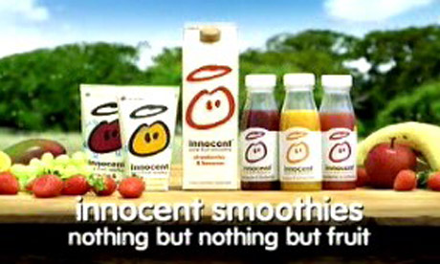
Businesses who have become successful for ethical & socially responsible activities
Innocent Drinks – Sales increased by 140% in 2009 compared with 2008 largely because they have built their brand around being socially responsible in their business activities
http://www.innocentdrinks.co.uk/us/ethics/

Slide 7
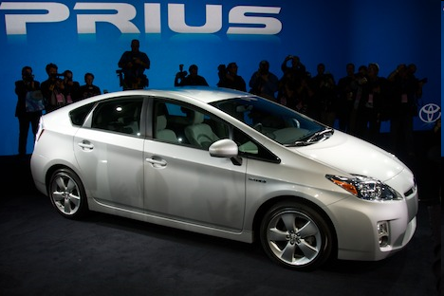
Businesses who have become successful for ethical & socially responsible activities
Toyota Prius – This is a hybrid car which uses very little petrol therefore does not pollute the environment – this enabled the Prius to become the number one selling car worldwide in 2009

Slide 8
What are the advantages for businesses of being socially reponsible?

Slide 9
Advantages of Ethical Behaviour
Marketing Advantages – e.g. The Body Shop develops ethical behaviour in to a USP – it promotes the way it supports poor communities in the less-developed world, hoping this will gain increased sales

Slide 10
Advantages of Ethical Behaviour
Public Relations Advantages – e.g. The Co-Operative Group announced a 12% increase in pre-tax profits in 2010, while confirming the maintenance of its ethical principles such as selling a high proportion of FairTrade products

Slide 11
Advantages of Ethical Behaviour
Positive Effects on the Workforce – Firms may expect to recruit staff who are better qualified and motivated – e.g. Innocent Drinks has 187 employees and has had only 201 different permanent members of staff since its creation in 1999. This is a very high rate of retention of staff and has meant that the company has reduced costs of recruitment & training

Slide 12
Task 1
Golden Virginia tobacco company have responded to declining sales in the western world by increasing production and sales in Asia and Latin America. Consumers in these countries are less knowledgeable about the dangers of smoking and more likely to purchase potentially harmful products
Oxford University has monitored the death rates from tobacco in several developing countries, including China. Their research has revealed that worldwide deaths from tobacco are likely to increase from about 4 million per year at present to about 10 million per year by the 2040s. An estimated 70% of these deaths will be in developing countries
1) Analyse the social & private benefits & costs of Golden Virginia increasing production in Asia and Latin America (8 Marks)

Slide 13
Golden Virginia
Social Benefits | Social Costs
More Jobs Easier Access to Tobacco Cheaper Tobacco from Golden Virginia may help the community in other ways | Health of workers Pollution of Environment Noise of factory build Exploiting cheap workers
Private Benefits | Private Costs
Cheap Labour Bigger pool of labour to choose from More sales to larger market Could lower prices because costs are low – this will increase sales further | Poor Reputation of company Low Sales from bad publicity Low quality production from cheap workers

Slide 14
Structure of Answer
Definition
Social Cost/Social Benefit
Private Benefit/Private Cost
Conclusion – overall benefit for society? Benefit for company?
MUST HAVE BUSINESS TERMINOLOGY
MUST HAVE APPLICATION TO THE BUSINESS

Slide 15
By Golden Virginia operating in Asia, they will be able to potentially increase sales and profits as it is a huge market that is largely uneducated on the negative effects of smoking and so is likely to atleast attempt a new tobacco company’s product range. However, in western cultures, it may decrease their sales even more as a company as they receive negative media attention for exploiting developing countries.

Slide 16
Within Asia however, the expansion of Golden Virginia may be seen as a positive growth strategy in terms of the community benefit as it will create more manufacturing jobs which will increase sales for other businesses as more people within communities will have capital to spend. However, workers will be risking their health working for a tobacco factory and in the long term the social cost could result in an increase in medical attention required for workers surrounded by tobacco which as in increase in Government costs for hospitals

Slide 17
Conclusion
Overall from a private company point of view, the expansion is a positive growth strategy as it will open them up to a market with over a billion new potential customers despite the potential negative PR in western cultures, the potential increase in sales could be much more lucrative. Socially the expansion will be a negative long term strategy as the health of thousands of workers will be negatively impacted however in the short term it will be a positive strategy for the local communities as it will provide much needed employment

Slide 18
Disadvantages of Ethical Behaviour
Reduced Profitability – Higher costs & also firms may have to turn down potentially high return investments because they go against their ethical policies
Conflict with Existing Policies – Can create internal divisions within the business – some may be concerned this behaviour will conflict with profits

Slide 19
RECAP QUIZ
1) Give two social costs of a business moving a factory in to a local community
2) Give two private benefits of a business moving a factory in to a local community
3) Give two advantages of business acting socially responsibly
4) Give two disadvantages of businesses acting socially responsibly

