Slide 1
Ansoff’s Matrix
IB 1.7 SL

Slide 2
Ansoff’s Matrix

Slide 3
Market Penetration
Market penetration is the name given to a growth strategy where the business focuses on selling existing products into existing markets.
Market penetration seeks to achieve four main objectives:
• Maintain or increase the market share of current products – this can be achieved by a combination of competitive ______ strategies, _____________, sales promotion and other promotion methods
Secure ________ of markets
Restructure a mature market by driving out competitors; this would require a much more aggressive promotional campaign, supported by a pricing strategy designed to make the market ___________ for competitors
PRICING
ADVERTISEMENTS
DOMIANCE
UNATTRACTIVE

Slide 4
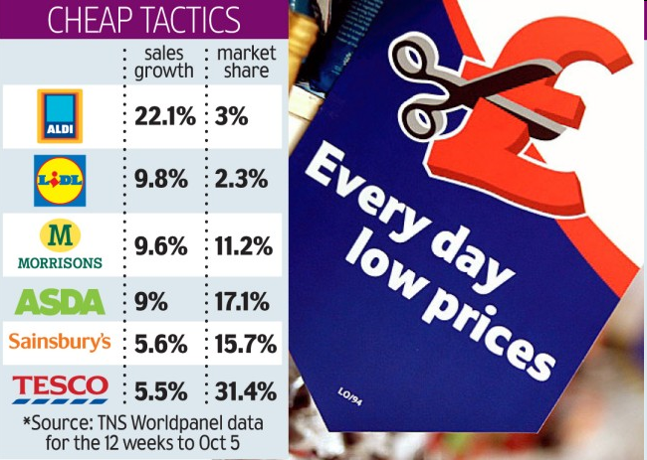
Limitation of Market Penetration
A limitation of this strategy is that competitors, especially stronger rivals, will react to firms trying to take away their customers and market share. This may lead to aggressive techniques, such as price wars, to the detriment of business profits

Slide 5
Market Development (Medium-Risk Strategy)
Market development is where the business seeks to sell its existing products into new markets.
There are many possible ways of approaching this strategy, including:
New __________ markets; for example exporting the product to a new country. E.g. Nokia and Motorola use market development to sell their mobile phones which have a short product life cycle in developed nations, to developing nations
New _________ channels
Different pricing policies to attract different customers or create new market segments
GEOGRAPHICAL
DISTRIBUTION

Slide 6
Product Development (Medium Risk Strategy)
Product development is where a business aims to introduce new products into existing markets. This strategy may require the business to develop modified products which can appeal to existing markets. E.g. McDonalds is frequently adding new products to its menus. Car manufacturers introduce new models and occasionally limited editions of their vehicles.

Slide 8
Diversification (High Risk Strategy)
Diversification is where a business markets new products in new markets.
This is an inherently more ____ strategy because the business is moving into markets in which it has little or no experience.
For a business to adopt a diversification strategy, therefore, it must have a clear idea about what it expects to gain from the strategy and an honest assessment of the risks.
RISKY

Slide 9
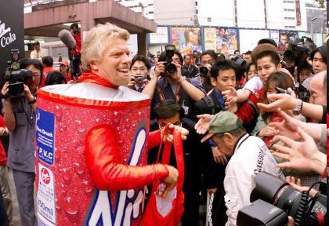

Slide 11
Limitations of Diversification
New distribution channels will also need to be established and this could be time consuming and costly for the firm. All these distractions can lead to an organization losing focus of its core business with serious consequences

