Slide 1
Economies and Diseconomies of Scale
IB Unit 1.7 - GROWTH

Slide 2
Learning Objectives
By the end of this lesson, students should be able to:
Evaluate PESTLE influences on a company’s objectives/strategies
Understand the six different economies of scale businesses can benefit from
Demonstrate knowledge of the six different economies of scale
Understand how a business can also suffer from diseconomies of scale

Slide 3
Evaluating the impact on a firm’s objectives and strategy of a change in any of the PESTLE factors
Once a PESTLE is carried out, the next step is to work out how much these external factors will impact on the firm and therefore should they alter their objectives and strategies to help better deal with these impacts.
Lets look at the online retail market…

Slide 4

Evaluating the impact on a firm’s objectives and strategy of a change in any of the PESTLE factors

Slide 5
STEEPLE on Music Industry 2008
Economic – Sales of Compact Discs had fallen with a US recession forecast. Fierce competition from the market leader in legal downloads – Apple iTunes
Social – The increasing confidence of consumers to order and pay for songs over the Internet
Legal – In order to build a library of songs, Amazon forms a strategic alliance with Warner Brothers to facilitate sales
Technological – Increased use of broadband and the increasing threat of rival, free, peer-to-peer sites such as Limewire
Political – Perceived weak Government action in prosecuting ‘music pirates’

Slide 6
Evaluation of Changing objectives as a result of STEEPLE analysis
Amazon’s decision, given the difficult trading conditions since January 2008, would appear to have been successful. A number of electronic retailers in the US and UK have since gone into administration and sales of legally downloaded songs has increased
Only drawback is they may have cannibalised their own market, with customers only buying individual tracks rather than whole albums.

Slide 7
Unit 1.7SL – Growth & Evolution
“Be not afraid of going slowly; be afraid only of standing still”
There are two methods of business growth and these are known as organic growth and external growth. Organic growth occurs when a business grows internally, using its own resources to increase the scale of its operations and sales revenue. Internal growth is typically financed through profits of the business.

Slide 8

How Businesses Grow….

Slide 9



The Growth of Firms
Firms grow in three main ways:
  1)Merging with other firms (External Growth) - A merger takes place when two or more firms agree to join together to become one larger firm. E.g.:

Slide 10


The Growth of Firms
Firms grow in three main ways:
  2)Taking over another firm (External Growth). – A takeover occurs when one firm buys control of another. This is achieved by buying enough shares in the firm to be able to outvote other shareholders. E.g.:

Slide 11
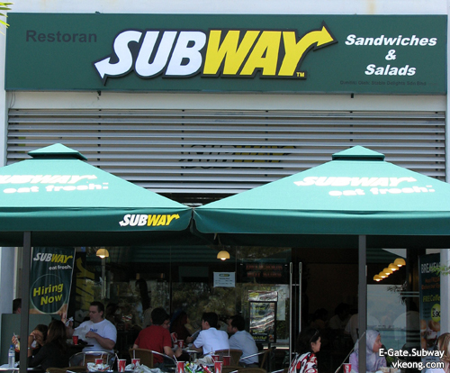
The Growth of Firms
Firms grow in three main ways:
  3)By Internal Expansion – This is when the business grows by increasing its production, perhaps by building a new plant or new shops by ploughing profits back in to the firm. E.g.:

Slide 12
Why is Bigger better?!?!
Definition – As the business grows, the firm’s unit costs decrease
As businesses increase their capacity of production they can benefit in so many ways from ECONOMIES OF SCALE
E.g:

Slide 13
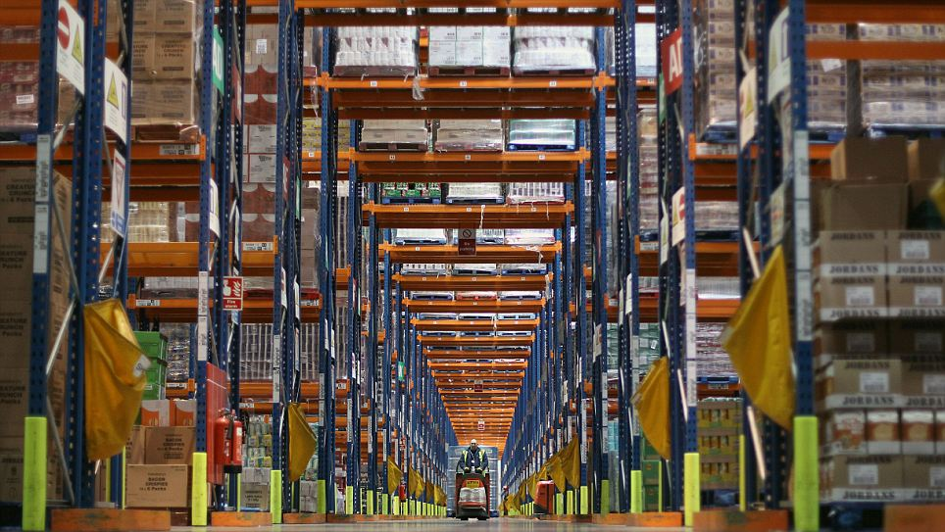
Sainsbury’s Distribution Centre

Slide 14
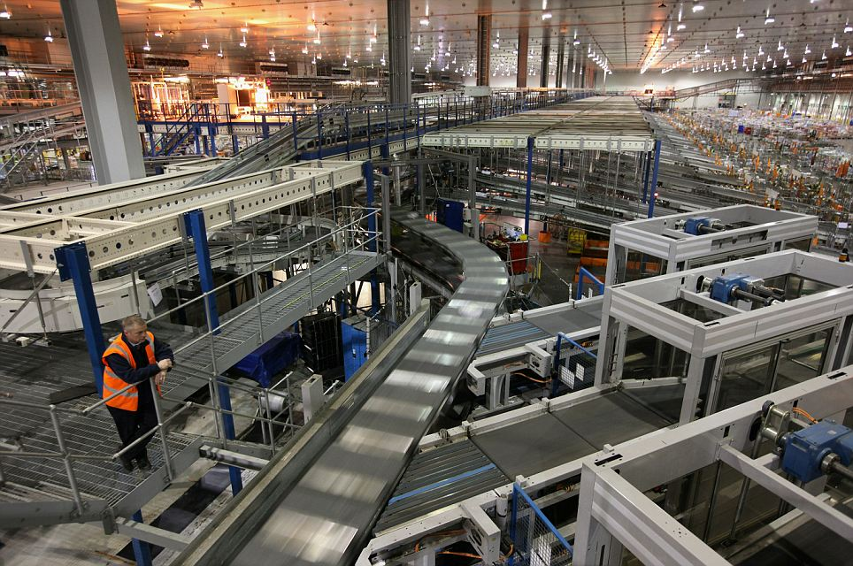
7kms of conveyor belts

Slide 15
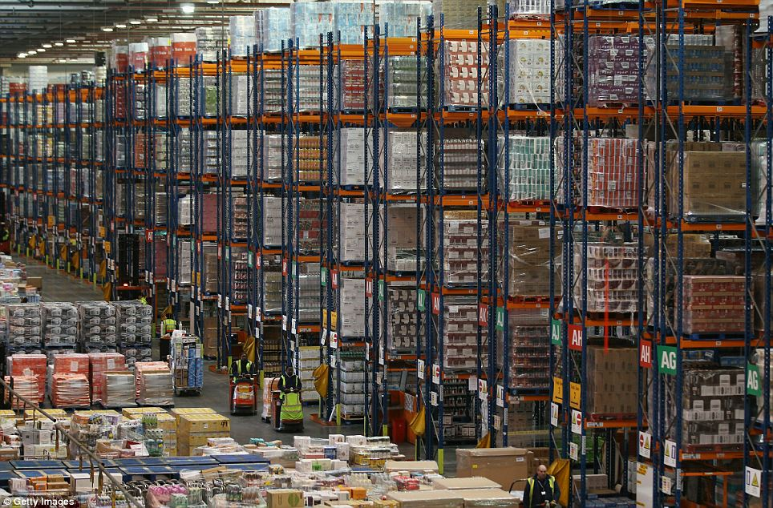
750,000 square feet (247 tennis courts)

Slide 16
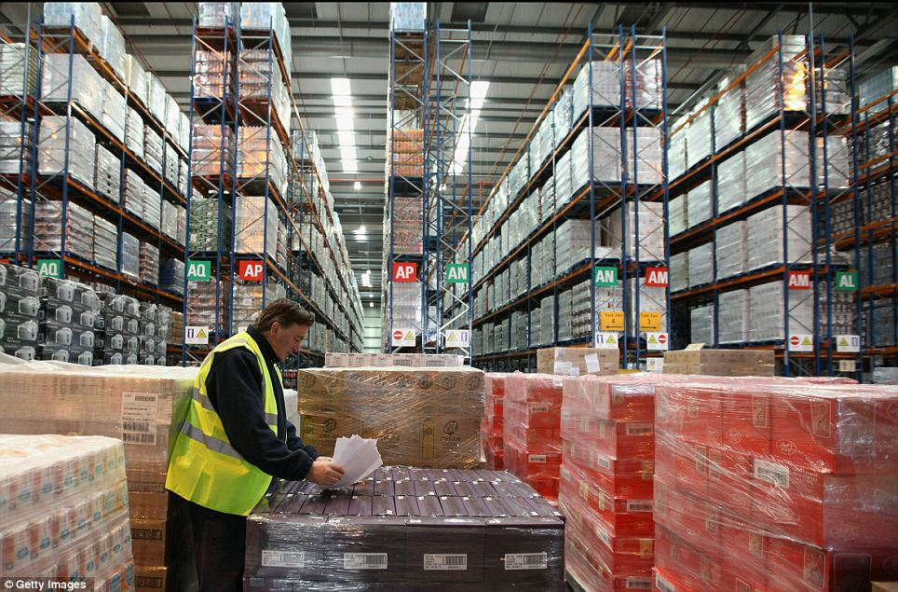
2 million cases a week

Slide 17
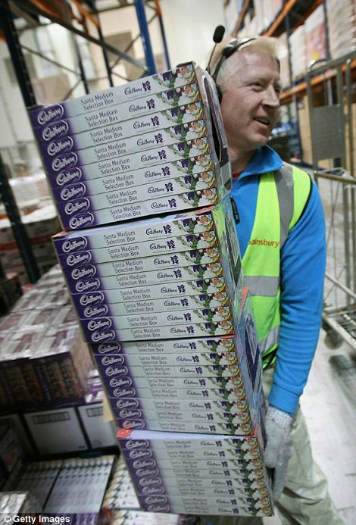
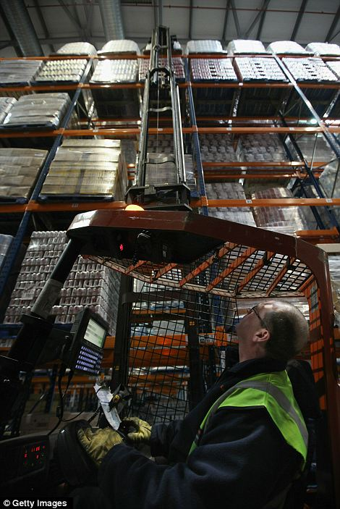
300 employees

Slide 18
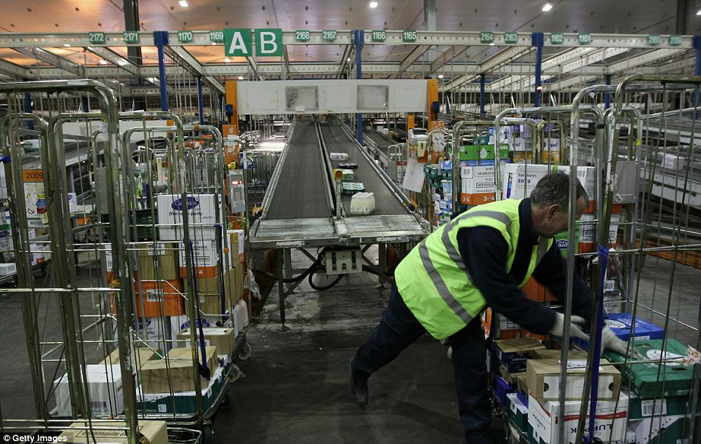

Slide 19
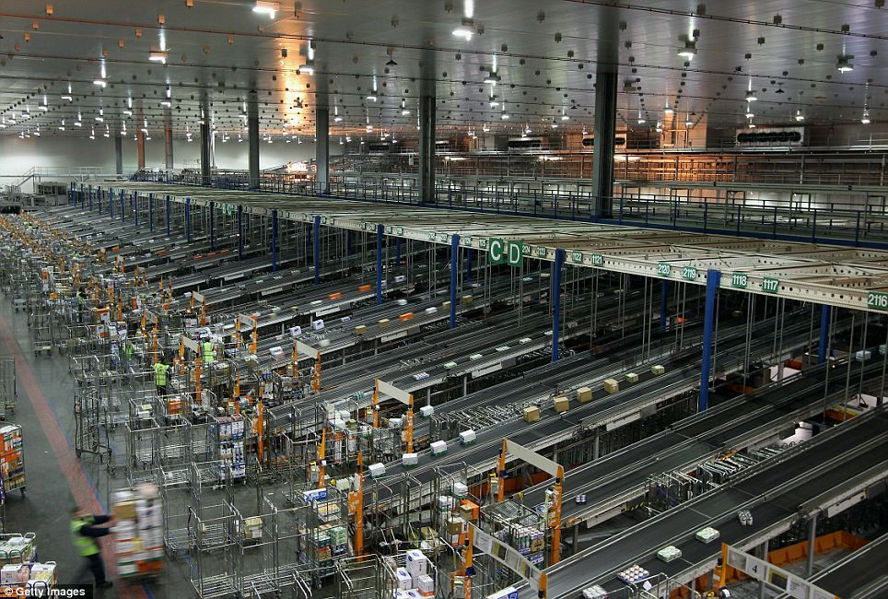
What benefits might a firm achieve through operating on this scale?

Slide 20
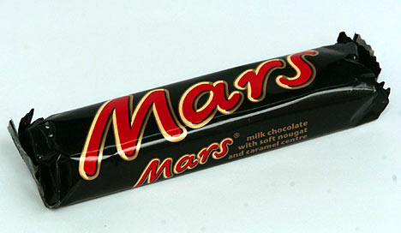
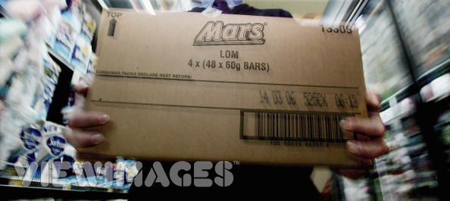
PURCHASING Economies of Scale
1 Mars Bar = 50 cents
Box of 50 Mars Bars = $10
Therefore 1 Mars Bar now = $10/50 = 20 cents
Therefore supermarkets such as Carrefour have the capacity to buy thousands of Mars bars, charge 40p per Mars bar cheaper than a newsagents and still make a healthy profit because the cost per unit is lower for Carrefour than it is for a smaller shops

Slide 21
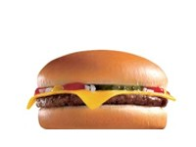
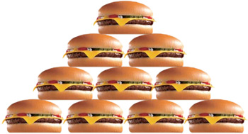
PURCHASING Economies of Scale
1 Cow = $2
1 McDonalds Cheeseburger = 69 cents
Therefore McDonalds would make a loss if they only made 1 cheeseburger a day
1 Cow = $2
10 McDonalds Cheeseburger = $6.99
Therefore because McDonalds have the capacity to produce and sell more cheeseburgers, they can buy cows in bulk and charge such a low price for their cheeseburgers and still make a healthy profit.

Slide 22
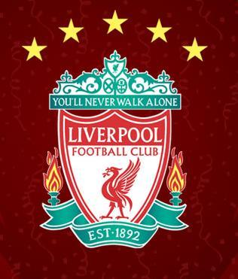

FINANCIAL Economies of Scale
Because Liverpool FC are such a large institution, the Royal Bank of Scotland was more willing to lend huge amounts of money to the club at very low interest rates to attract such a large customer.
So it is easier for large firms to raise capital, and larger firms benefit from lower interest rates

Slide 23
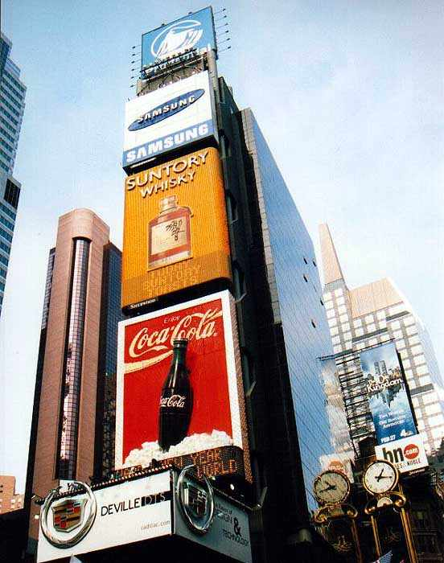

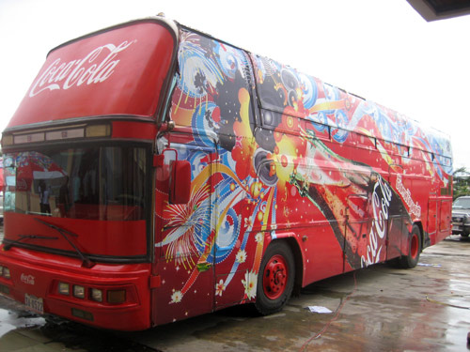
MARKETING Economies of Scale
Coca-Cola advertises globally which is very expensive but compared to the total amount of products they sell, the cost is spread and this results in a low unit cost for Coca-Cola

Slide 24
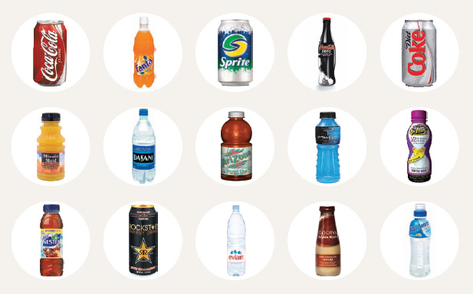
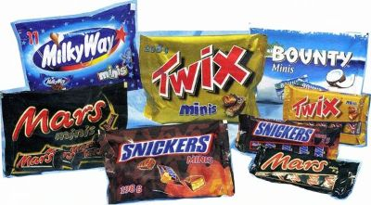
RISK-BEARING Economies of Scale
Firms such as Coca-Cola & Mars are so large they sell a huge range of products so they do not just rely on one product to be successful. If one product fails they have many other products to keep the company successful and profitable

Slide 25
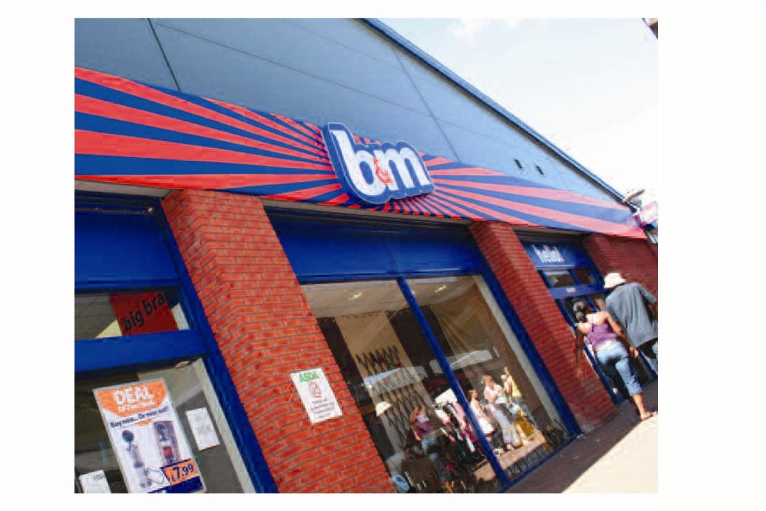
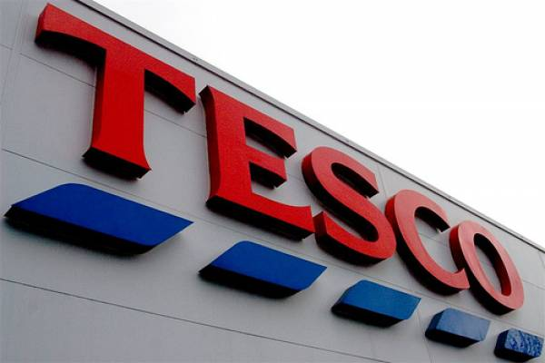
MANAGERIAL Economies of Scale
Firms such as Carrefour are large enough to afford to employ specialist managers who improve the efficiency of the firm. Whereas small firms like B&M can’t afford specialists like this

Slide 26
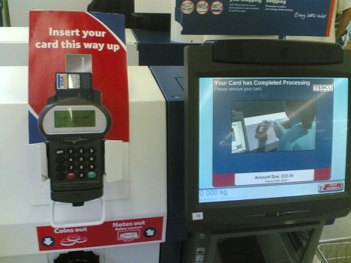
TECHNICAL Economies of Scale
Firms such as Tesco are large enough to afford to save on costs by using better methods and equipment such as self-serving machines saving money in the long-run on labour costs

