Slide 1
Globalisation
IB SL BUS 1.9

Slide 2
Learning Question
In what ways are MNC’s and countries impacted by globalisation?

Slide 3
Learning Objectives
By the end of this lesson, students should be able to:
Define Globalisation and MNC’s (ALL)
Demonstrate understanding of how MNC’s are affected by globalisation (MOST)
Demonstrate understanding of how host countries are impacted by the increase in globalisation (MOST)

Slide 4
RECAP – What are the six different economies of scales that Multinational Corporations can benefit from?

Slide 5
Business Quote of the Day!
“In business, the competition will bite you if you keep running. If you stand still, they will swallow you” William Knudsen (1879-1948) Former president of General Motors

Slide 6
Globalisation Definitions
“The growing integration, interdependence and general connectedness of the world through markets, labour mobility and capital transfer”

Slide 7
Multinational Corporation (MNC)
One which operates, owns and controls resources outside its country of origin. A company is not considered an MNC if it merely sells abroad

Slide 8
MNC’s and Globalisation in Practice
Multinationals such as McDonald’s and Coca-Cola design and market their products to a world audience. Consumers around the world easily recognise and have similar tastes for their products. With McDonalds, even the production processes are the same throughout the world; burgers and fries are cooked in exactly the same way irrespective of where the McDonald’s restaurant is in the world
The outcome of globalisation is that markets, cultures and tastes have converged at an accelerating pace.

Slide 9
Which of the following are MNC’s?

Slide 10
Which of the following are MNC’s?

Slide 11
Which of the following are MNC’s?

Slide 12
Which of the following are MNC’s?

Slide 13
Which of the following are MNC’s?

Slide 14
Which of the following are MNC’s?

Slide 15
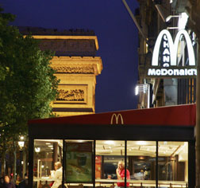
Examples of globalisation’s impact on MNC’s
McDonalds in France – Glocalisation - success

Slide 16
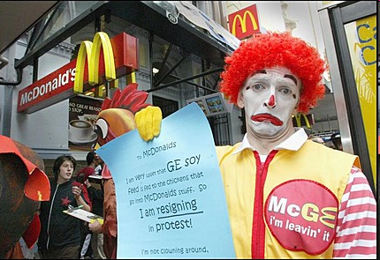
Examples of globalisation’s impact on MNC’s
Is it all rosy and successful?

Slide 17
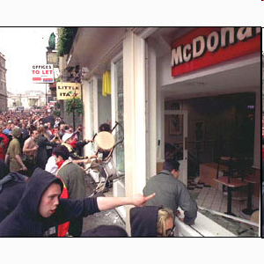
Why is Globalisation Controversial?
Jose Bove’s arguments against globalisation:
Everywhere in France was starting to look the same
Globalisation was built on exploitation – the strong exploiting the weak
That it may make it hard for local producers to build and grow in a way that is suited to local needs

Slide 18
Shell in Nigeria
UN slams Shell over Nigeria video:
http://www.youtube.com/watch?v=YmI3xjZk_y0

Slide 19
Have Nigeria benefitted from Shell and Globalisation?
Nigeria is oil-rich and over past 15 years more than AED 300 billion of oil has been exported from the country
This has been good for Shell and BP, but the people of Nigeria have little benefit to show for all this wealth
Infant mortality rates are higher than anywhere in the world – oil pollution, no money for medicine
Corruption is high because of oil
Therefore people of Nigeria have gained little from globalisation – rich are richer, majority of poor are poorer!

Slide 20
Group Activity
4 groups to try and think of as many answers as possible to following:
Group 1 – What are the benefits to a host country of globalisation and MNC’s
Group 2 & 3– What are the drawbacks to a host country of globalisation
Group 4– What are the benefits of globalisation to a Multinational Corp
Group 5– What are the disadvantages of globalisation to a Multinational Corp

Slide 21
Benefits of Globalisation to the MNC’s
EOS
Lower Costs
Sharing of good practice & knowledge – improve efficiency and quality
Spread global brand – increase sales
Identify new market opportunities

Slide 22
Drawbacks of Globalisation to MNC’s
Bad P.R. as local people may not warm to them - People believe that MNCs don’t have long-term loyalty to a country and will pull out if negative changes happen to the external environment
Poor working conditions for labour may impact negatively on image
Difficult to control consistent image in different cultures
A lack of local knowledge and experience may create problems for firms operating in new markets
External factors (those beyond the control of a business) have a greater weighting in decision-making. These may create problems or limitations for the MNC, such as legal restrictions, language barriers and cultural differences

Slide 23
Benefits of Globalisation on host countries
Creation of new jobs, employment opportunities
Revenue-raising opportunities for the host government
Importation of new technology, skills and management techniques
Increase in choice of goods and services available for host country which attracts more tourists

Slide 24
Drawbacks of Globalisation on host country
MNC’s may hurt sales/profits of domestic businesses
This can also cause unemployment
A lack of social responsibility may exploit a countries resources, e.g. Shell in Nigeria, this may be irreparable
Labour may not be treated with care by foreign MNC’s in terms of working conditions/wages

