Slide 1
2.5 Motivation Theories - SL
2.5 IB BUS MGT
Mr Greenbank

Slide 9
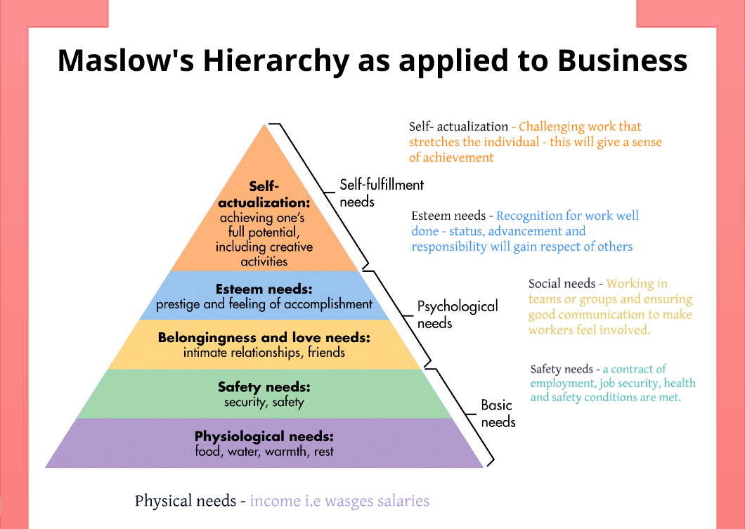

Slide 11
