Slide 1
Ratio Analysis Past Questions
IB BUS MGT 3.6

Slide 2
CU Ltd – a) Calculate the Working Capital (2 Marks)

Slide 3
CU Ltd – c) Examine the value of these accounts to the board of directors of CU Ltd (4 Marks)

Slide 4
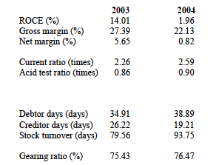
CU Ltd – d) Using appropriate liquidity, efficiency and profitability ratios analyse the financial position of CU Ltd (10 Marks)

Slide 5
CU Ltd – d) Using appropriate liquidity, efficiency and profitability ratios analyse the financial position of CU Ltd (10 Marks)
There is evidence of poor credit control. The number of debtor days has risen and creditors seem to have been paid even quicker.
There is a clear problem with excess stock and the stock turnover (in days) has risen fast indicating deteriorating stock control
Gearing has risen slightly and is quite high. This will leave the firm vulnerable and at risk

Slide 6
CU Ltd – d) Using appropriate liquidity, efficiency and profitability ratios analyse the financial position of CU Ltd (10 Marks)
Profitability has deteriorated sharply despite growth in sales. This appears to be mainly due to a rise in cost of goods sold.
The current ratio is very high and on first appearance may even be considered too high, but when compared with the acid test ratio, it is clear that there is a problem with the liquidity of the current assets with the vast majority held as debtors and stock.

