Slide 1
4.1 Role of Marketing
IB BUS MGT
Mr Greenbank

Slide 3
Lesson objectives
By the end of the lesson students should be able to: -
Define and understand the concept of marketing
Understand how market size can be measured
Describe the concepts of market and product orientation
Explain the differences between the marketing of goods and services

Slide 4
What is marketing?
“the management process involved in identifying, anticipating and satisfying consumer requirements profitably.”
Chartered Institute of Marketing

Slide 5
A business will be interested in three elements of the market in which it operates:
Size of the market
Growth rate within the market
Firm’s share of the market

Slide 6
i) Market Size
Market size can be measured in a number of ways
Customer base- the total number of potential customers. E.g. India and China
Barriers to entry- the number of suppliers in the market – Is it too difficult to get into?
Location- some markets focus on a particular area.
Total Sales – the total sales of all companies in the market

Slide 7
Continued…
c. Location
Some markets focus on particular area, country, or region.
Ex:
Adidas is the market leader in supply of Taekwondo equipments in Korea → where four-fifth of the world’s black belt holders are located.
One billion vegetarians live in India. → Size of market is not limited to the domestic markets only.

Slide 8
Market size
Market size can represent all the sales of companies in a market.
Market size by volume measures the amount of goods sold by quantity, for example litres of milk.
Market size by value measures the amount spent by customers on the total volume sold.
E.g. UK Crisp, snack and nuts market
Market size by value: £1.99 Billion
Market size by volume: 9 billion bags

Slide 9
II. Market Growth
Refers to an increase in the size of a market over a period of time, usually per year.
Can be measures by an increase in the value or volume of sales in the market.
Usually expressed as a percentage.
Ex: If sales revenue of a particular market increases from $100 million to $110 million in 2011 → the market has experienced 10% growth in 2011.
Market growth will attract more suppliers to enter the market due to the potential profit gains.

Slide 10
Market Share
Market share refers to a firms share of that market
Market Share
= Sales Revenue of company Y x100
Total sales revenue in market

Slide 11
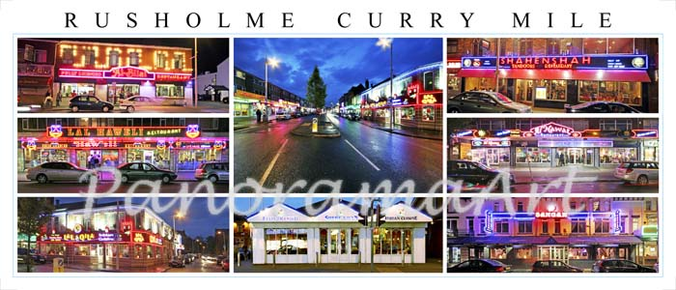
Features of a Monopolistic Competition Market
There are many buyers and sellers
Product/service slightly different
Easy to enter or leave market
Usually Low Profit Margins

Slide 12
Features of an Oligopoly Market
A few firms are responsible for most of the sales in a market
High barriers to entry
High profit margins but high spending on promotion needed

Slide 13
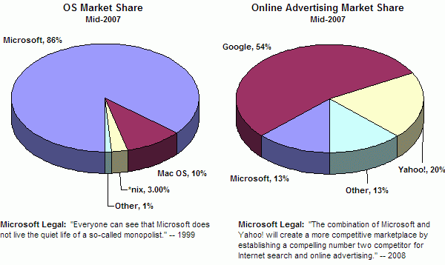
Features of a Monopoly Market
A single company owns most or all of the sales of that market
One producer sells at least 25% of total market sales
Unique product
Price Leader

Slide 14
Market Share Nokia
Calculate Nokia’s Market share if the total market sales revenue was $11.2 billion and Nokia’s sales revenue was $2.7 billion

Slide 15
Market Share Nokia
Explain two advantages that Nokia might enjoy by having a larger market share than its rivals

Slide 16
Answer
Benefit from economies of scale for large scale operations
Nokia’s stakeholders remain confident and motivated with the company – shareholders will want to invest more
Larger firms like Nokia likely to have the funds to research & develop new products
Brand recognition globally will give potential for more sales – new generation of customers

Slide 17
Continued…
In reality, marketing works alongside the other business functions, such as:
Operations Management
Production department will work closely with the marketing department in using sales forecasts (from market research) to prepare their production schedules.
These departments will also work together to research, develop, and launch new products.

Slide 18
Continued…
Finance
Will work closely with the marketing department to set appropriate budgets.
Conflict occurs.. Why?

Slide 19
Continued…
Human Resource Management
Marketing data can help the HRM department to identify staffing needs. (production staff / sales personnel)
HRM department role is to ensure the business has the right quantity and quality of workers through effective workforce planning to meet the customer needs.

Slide 20
4.1 SL Market and Product Orientation
Product Oriented Marketing: *Marketing used to focus on getting customers to buy the product that businesses felt their customers needed or wanted.
Market Oriented Marketing: * Marketing activities are used to gain a competitive advantage over rivals by focusing on meeting the actual needs and desires of their customers.

Slide 21
1. Product Orientation
Adopted by businesses that are inward looking.
Focus on selling products that they make, rather than making products that they can sell.
Many hi-tech products such as MP3 players and mobile phones were created using a product orientation approach.
Even Henry Ford didn’t originally realize that the automobile would become a mass market products, worldwide!
Hit-and-miss production/selling.

Slide 22
So what can happen with Product Orientation?
Sinclair C5
Sold in 1985
Launch January
Production stopped August
No Market Research
£12 million to produce
FAILURE
Task
Give some examples why you think it failed
What could they have done to avoid the failure
Could only travel 15mph
Engine made by Hoover
Range 10km

Slide 23
Product Orientation
http://www.youtube.com/watch?v=0EQetm_qWDg
http://www.youtube.com/watch?v=l5N937V8ZOw

Slide 24
Continued…
They believe customers will be willing to pay a higher price for exclusivity and luxury.
Advantages:
Quality can be assured as no pressure to cut costs in a competitive market for the product/service because it is a unique product/service
Firm has more control over its activities as they are not pressured to deliver certain specifications that customers want

Slide 25
Continued…
Disadvantages:
Since the needs of the market are ignored (i.e. changes in fashion and taste) many of these businesses face a very high risk of failure.

Slide 26
2. Market Orientation
Focus on making products that can sell, rather than selling products that they can make.
Focuses on consumer to:
Identify
Design
Develop
Supply, products needed by the consumer.

Slide 27
Continued…
Information is gathered usually through market research, thus
If the consumer is ignored, firms will lose competitiveness in the market and incur bad results in the long-run.
IKEA started providing added facilities to meet the needs of their customers:
Restaurants, adult-supervised play areas for children, free parking.

Slide 28
Continued…
Businesses worry about the cost of NOT doing things for the customers, not the other way around.
Advantages to a business in being market oriented:
Flexibility
Firms can respond quicker to changes in the market due to access to relevant data and information.
Less Risk
Since products are purposely catered to meet requirements of consumers there is a higher chance of success.

Slide 29
Continued…
Disadvantages:
Market research is very expensive.
Given the dynamic nature and of the business environment and the uncertainly level of the future, there is no guarantee that this approach will lead to success.

Slide 30
Market Orientation
implies that the business will focus on the needs of the customer before taking decisions about the produce, its price and the way it is promoted. (Nuffield pg 57, 2005)
Or needs and wants come before the product
Question! Consider whether Coca-Cola and Gillette are product orientated or market orientated?

Slide 31
Market or Product Orientation?

