Slide 1
4.3 Product
IB BUS MGT
UNIT 4
MR G

Slide 2
YR2 Plan
IA drafts and final submission December 17th
Wk1 – 4.3 Product & 4.5/4.6 Quiz
Wk2&3 – 4.4 Price
Wk4 – 4.7 & 4.8 International Marketing & E-Commerce
WK5 – End of Unit 4 Test
Half Term
Wk 6 to Xmas – Unit 3 Finance
Jan to MY Exams – Pre Release Case Study
Semester 2 – Unit 5 Production & Revision
Goodbye, Godbless

Slide 3
Exam Requirements for 4.3
Classify products by line range and mix.
Describe the importance of innovation in an era of rapid technological change and discuss the problems of financing research and development.
Analyse the relationship between the product life cycle and the marketing mix, and determine appropriate extension strategies.
Analyse the relationship between the product life cycle, investment, profit and cash flow.

Slide 4
Exam Requirements for 4.3
Apply the BCG matrix to a given situation. Use the BCG matrix to help in developing future strategic direction.
Discuss the importance and role of branding.
Distinguish between different types of branding.
Analyse the role of branding in a global market.

Slide 5
4.3 PRODUCT SL
Product is probably the most important element in the marketing mix to get right – a marketing mix that has an original promotional campaign backed by a competitive price strategy and a wide distribution network can fail if the product does not satisfy consumer expectations or work at all!

Slide 6
PRODUCT AND COMPETITION
It is unlikely that an established firm will concentrate on one product – they will want to produce a range of products to stay competitive and to spread the risk incase one product fails, they have other products to bring in profits – this is what has made virgin so successful…

Slide 8
PRODUCT INNOVATION AND TECHNOLOGICAL CHANGE
As technology changes and gets better at a faster rate each year, it is vital some companies change some of their product portfolio in order to stay competitive or to even survive! E.g. Apple changes their product portfolio constantly:

Slide 9
APPLES PRODUCT INNOVATIONS as of 2013
Apple Product | First Appeared | Number of Re-Incarnations
iPod | 2001 | 7
iPod Nano | 2005 | 6
iPod Shuffle | 2005 | 3
iPod Touch | 2007 | 3
iPhone | 2007 | 7
iMac | 1998 | 10+
iPad | 2010 | 4

Slide 10
Best product Innovations of 2012

Slide 11
1) Product Innovations
Innovation and new product development are crucial in high technology industries as life cycles tend to be short and development costs high. Firms need to protect market share by maintaining unique products through copyright or being “first to market”.
R&D is very costly as a lot of prototypes fail and it is also highly labour intensive requiring highly skilled staff, who are often in short supply. This adds to the high costs involved.
The use of venture capital, joint ventures and start up grants for small firms is therefore crucial. Often banks will not lend the required funds as the projects carry such a high level of risk.

Slide 12
2) How does Market research assist in Product Development?
Given the high failure rate of new products in the marketplace, market research is a crucial element of new product development.
Dyson’s engineering team will want to know how the product being developed is perceived by the market
Customer requirements will be uppermost in the minds of Dyson’s designers. They want to know what functions are required, and whether these are economic in production.
Primary research can be used to establish customer requirements. Secondary research will be useful to establish market trends and preferences.

Slide 13
Classification of Products
Product Line:
A variety of the same product that a business produces for customers of a particular market.
Products in a product line usually differ in color, size, price, or quality so that there is a greater chance that each product meets the needs of different customers.
Ex: Samsung producing TVs, Walkers producing crisps.
Product Mix: (Product Assortment)
Describes the variety of the different product lines that a business produces.
Example: IKEA produces sofa, desks, carpets, food .. Etc.
Advantages: spread risk + selling to larger customer base due to the verity involved in the “product portfolio”.

Slide 14
Continued…
Product Range:
Refers to all products lines of a firm’s product mix (all the products sold by the business).
Example: Apple Macintosh
Product Range
All ranges of iPods, laptops, mobile phones, accessories
iPods, laptops, mobile phones, accessories
iPods: different color, size .. Etc.
Product Mix
Product Line

Slide 15
Product Portfolio Analysis
We will look at two models to analyse this:
1) Product Life Cycle
2) Boston Matrix

Slide 16
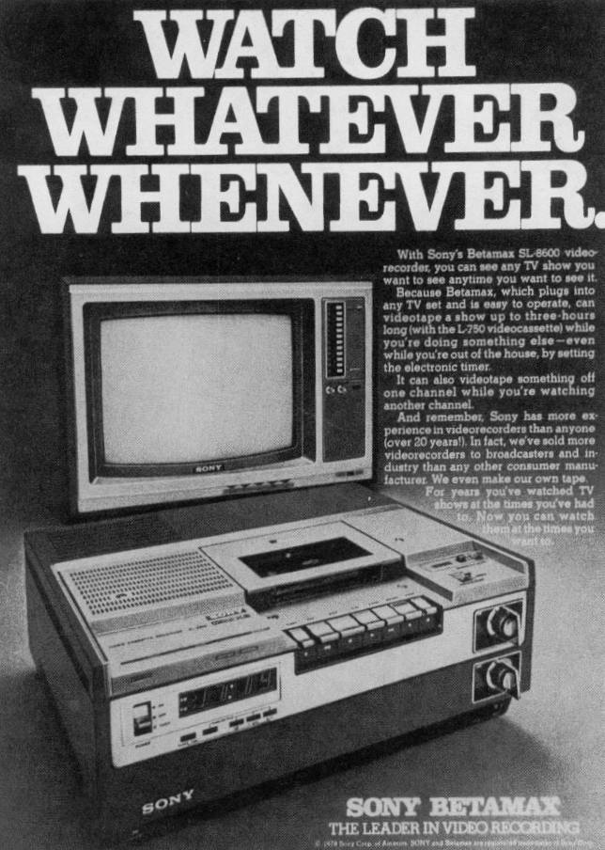

Slide 17
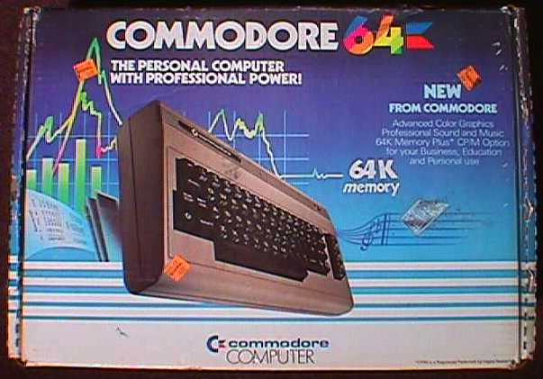

Slide 18
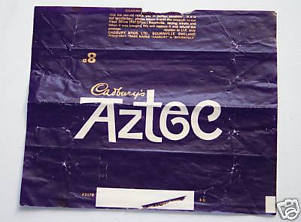

Slide 19
The Product Life Cycle
Most products have a lifespan which is represented by the product life cycle (PLC)
The length of a products life cycle will vary enormously from to product to product (or services)
The stages of the Product Life Cycle are as follows

Slide 20
Product Life Cycle
Sales Revenue ($)
Time

Slide 21
PLC and its relationship with investment, profit, and cash flow
PLC Stage | Investment Level | Profit | Cash Flow
R&D | Very high (R&D) | None | Highly negative
Launch | Very high (Marketing) | Little, if any | Negative
Growth | High (Persuasive) | Yes – Rising | Positive
Maturity | Less (Mainly reminding) | High – Little or no growth | Positive
Saturation | Extension strategies | High – Stable | Positive
Decline | Little, if any | Yes, but falling | Positive, but falling

Slide 22
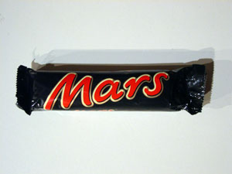
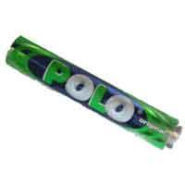
Identify where following products are on the PLC

Slide 23
I Pod Product Life Cycle

Slide 24
Extension Strategies
“Refer to any means of extending the product’s life cycle and delaying its decline.”
Implemented at the ‘saturation’ or ‘decline’ stage.
Example: Apple iPod
Common extension strategies include:
Price Reductions – to get rid of excess stock and increase demand.
Redesigning – introducing new features or “limited editions” to add value to the product.
Repackaging
New Markets
Promotion – helps remind customers about the benefits of purchasing the product.

Slide 25
Continued…
Boston Consultancy Group Matrix [Boston Matrix or BCG Matrix]:
Is a marketing planning tool which helps managers to plan for a balanced product portfolio.
Looks at two dimensions: Market share and market growth, in order to assess new and existing products in terms of their market potential.
Limitations:
Assumes that higher profits come from higher market share.
Fails to explain the root causes of positioning the products in the grid.

Slide 26
Continued…

Slide 27
Continued…
Possible results of the BCG matrix include:
Dogs
Problem children
Stars
Cash cow

Slide 28
A. Dogs
Products with a low market share operating in a low growth market.
Dogs do not generate much cash for the business as the market tends to be dull or declining.
Thus, business may try to dispose of these products.

Slide 29
B. Problem Children / Question Mark / Wild Card
Refers to products that operate in high market growth sector, but have low market share.
A business should develop strategies to gain higher market share.
The main users of cash in the BGC Matrix.
Not always obvious whether a business should invest more in these products.
Rising Star: “a problem children moving into the Star category.”

Slide 30
C. Stars
High market share and high growth markets.
Highly successful products that tend to generate high amount of cash.
Thus, businesses will tend to invest money in developing and promoting their Stars.
It is hoped that starts will eventually turn into cash cows.
The cash generated from stars can be used to turn some wild cards into starts.

Slide 31
D. Cash Cow
High market share operating in low growth markets.
Markets tend to be mature markets and products are very well established.
Thus, operating outstanding net cash flow.
Cash Cows provide businesses with large amount of profits and have good profit quality (ability to earn long-term profits).
Some Cash Cows run the risk of becoming Dogs.
Thus, businesses tend to use extension strategies to extend their high earning potential.

Slide 32
BCG Matrix and Business Strategy
Product Portfolio Analysis helps managers determine the business strategy.
Four strategies can be linked to the BCG Matrix:
Build Share Strategy:
Turns “?” into stars by investing resources to gain market share.
Harvest Strategy:
Turning starts into cash cows (i.e. gain as much money out of it whilst it is a star). Involves collecting profits.
Hold Strategy:
Investing enough resources to keep the product where it is in the matrix. Minimal investments as market growth will be low. Can’t do much about popularity of the market so just try and gain as much as can where it is
Divest Strategy:
Phasing out dogs. Release resources to be used elsewhere.

