Slide 1
4.6 PLACE (Part of the 8P’s of the Marketing Mix)
IB BUS MGT
L GREENBANK

Slide 2
4.6 Learning Outcomes for Exam
You must be able to:
Discuss the effectiveness of different types of distribution channels.
Evaluate the effectiveness of different types of distribution channels including producers, wholesalers, agents and retailers.
Examine how organizations can increase the efficiency of the supply chain.

Slide 3
4.6 PLACE - Traditional Channels of Distribution
Distribution or placement is one of the four main components of any marketing mix.
Chain of Distribution: “means of getting a product to customer.”
Intermediaries: “agents or firms that act as a middle person in the chain of distribution between the manufacturers and the consumers of the products.”
Traditional chain of distribution consists of: manufacturers, wholesalers, and retailers.
The long chain of distribution has two disadvantages:
Not appropriate for perishable goods (time).
Raise prices as intermediaries add profit margins to the original price.

Slide 4
Philip Kotler : Levels
Kotler defined distribution channels as “levels”:
Zero-level channel
No intermediaries
Producer sells directly to customers
Examples: direct mail, e-commerce, telesales, mail orders, hotel and restaurant reservations.
One-level channel
Had one intermediary, such as retailers or distributors.
Example: real estate agents are used to sell residential and commercial property on behalf of their clients.
Two-level channel
Has two intermediaries: wholesalers and retailers.

Slide 5
Continued…
Producer
Consumer
Producer
Consumer
Retailers
Wholesaler
One – Level Channel
Producer
Consumer
Agents
Producer
Consumer
Distributors
Producer
Consumer
Retailers
Zero – Level Channel
Two – Level Channel

Slide 6
Main types of intermediaries:
Wholesalers
Distributors and Agents
Distributors
Agents or Brokers
Retailers
Independent Retailers
Multiple Retailers
Supermarkets
Hypermarkets
Department Stores

Slide 7
A. Wholesalers
Businesses that purchase large quantities of products from a manufacturer and the separates the bulk purchases into smaller units for resale to retailers.
Are intermediaries between producers and retailers.
Benefits:
Bears the costs (space) of storage.
Eliminates the need for retailers to purchase huge quantities directly from a producer.
Lower transaction costs (invoicing and transportation) incurred by the producer.
The manufacturer is more focused on production as the wholesaler deals with distribution issues and problems.

Slide 8
Continued…
Limitations:
The producer takes a risk in passing on responsibility of marketing the firm’s products.
Some retailers (such as hypermarkets) do not use wholesalers as their suppliers, thus the wholesaler is cut out.

Slide 9
B. Distributors and Agents
Distributor:
Independent and specialist businesses that trade in the products of only a few manufacturers.
Example: Car distributors typically sell the products of one manufacturer to the consumer.
Agents / Brokers:
Negotiators who act on behalf of buyers and vendors (sellers) of a product.
Not employed usually by the producer, but used as intermediaries to help sell the products.

Slide 10
Continued…
They are experts in their markets and charge commission (a fee based on the level or percentage of the sales made).
Will usually offer a range of products from various suppliers for the consumer to choose from.
They tend to rely on personal selling techniques, such as door-to-door selling, telesales, trade fairs and exhibitions… WHY?

Slide 11
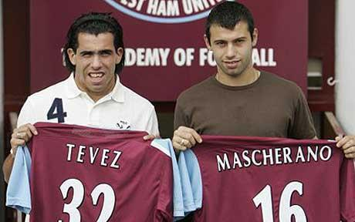

Slide 12
C. Retailers
Are sellers of products to the final consumer.
They have the ability to reach large number of consumers, especially large multiple retailers that have a global reach.
Most businesses will use a range of channels to distribute their products (multichannel distribution).
Example: Airline companies use travel agencies, internet, and airport outlets.. Benefits?
Most retailers rely on stocking well-known brands to attract customers.
They decide on the stock range (shelf space) based on sales per square meter.
Prime space (entrance to store or busier areas of outlet) is dedicated to better selling products or clients that pay higher rents.

Slide 13
Continued…
Types of retailers:
Independent Retailers
Small local sellers, often operating as sole proprietorship.
Usually sell a small range of products or are specialist outlets (ex: hair salons)
Multiple Retailers
Also known as Chain Stores.
Have several or many outlets (Ex: McDonald’s, Mothercare).
Have the advantage of being able to establish customer familiarity and brand loyalty.

Slide 14
Continued…
Supermarkets
Retailers that mainly sell foodstuffs.
They tend to buy their products directly from producers.
Hypermarkets
Also known as superstores.
Huge outlets that stock foodstuff and consumer durables.
Tend to be located in out of town areas where the space is available and the cost of land is relatively low.
Department Stores
Retail outlets that sell a large range of products (Ex: furniture, clothing, kitchen equipment, jewelry, cosmetics).
Usually franchisors run different parts of the department store.
Are built over several floors and are located in buy retail districts.

Slide 15
Direct Marketing as a channel of distribution
Direct marketing: “refers to the direct selling of products to the consumer (marketing without the use of intermediaries).”
Advantages:
Profit is not shared (no intermediaries).
Firm has direct control over their marketing.
Due to improvements to online payment security, e-commerce is becoming more popular among customers and thus covers a wider range of customers.
Can reach potential customers that don’t have easy access to retail outlets.
Cheaper than above-the-line marketing techniques.
Example: Telesales, e-commerce, vending machines, and direct mail.

Slide 16
Types of Direct Marketing:
Telesales:
Aka: telemarketing
The use of telephone systems (calls, texts) to sell products directly to potential customers.
Commonly used by firms that have a database of existing clients.
Disadvantages:
Mass telephone calls can be expensive
Disliked by many customers

Slide 17
Continued…
Direct Mail:
Involves a business sending promotional material via the mail system to entice customers to buy the firm’s products.
Used by business that have a database of customers.
Advantages:
Can provide personalized communication.. How?
Can be at low cost especially if the database is huge.
Detailed information aimed at different market segments can help boost sales as the mail is individualized.
Limitations:
Usually considered as “junk mail” and information in the database can go out of date.

Slide 18
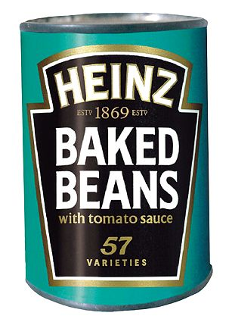

Slide 19
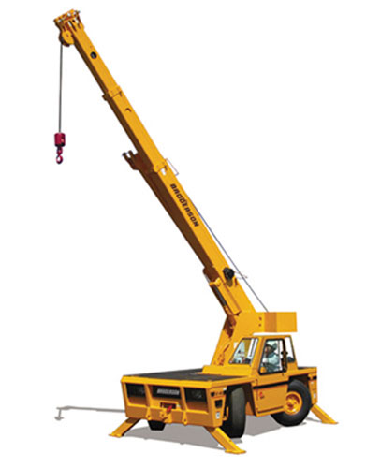

Slide 20
Choosing an appropriate distribution channel:
Factors that can affect the distribution decision of a business:
Cost and benefits
Access to customers vs. cost
Product
Fast Moving Goods
Perishable goods
Market size and characteristics
Local vs. international
Time
Direct vs. e-commerce
Legal constraints
Example: license to sell alcohol
Exam Tip:
Define channels of distribution.
Methods of transport vs. intermediaries.

Slide 21
Continued…
E-commerce:
Trading via the internet.
Advantages of e-commerce .. Discuss!
An effective way to reduce costs and risks of international marketing.
Not all products are suitable for online trading .. Example?
For most retailers, the internet is not a replacement for the traditional distribution activities, but complements and supports the marketing strategies.

Slide 22
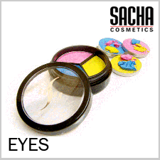
Sasha Cosmetics

Slide 23
Internet Effective Distribution Channel?
Arguments FOR
E-Commerce reduces the need for intermediaries, therefore reduces costs and allows more profit margins
Keep direct control over marketing and supply of products rather than using agents
More cost effective way to market on internet rather than traditional above the line techniques
Internet becoming more popular to do business on – more convenient and flexible

Slide 24
Internet Effective Distribution Channel?
Arguments AGAINST
Having online presence does not make customers more likely to choose you – every brand has online presence these days!
Online security issues – credit card fraud!
Overall
Internet has proven to be highly successful distribution channel as it is flexible, convenient and international reach BUT must not just rely on that – need other distribution channels, i.e. Wal-Mart & Celebrity endorsements, to ensure success

Slide 25
Supply Chain Management (SCM)
HL
Also known as: Logistics.
“Is the art of managing and controlling the sequence of activities from the production of a good or services to it being delivered to the end user.”
Supply chains must be efficient and cost effective in order for the business to be profitable.

Slide 26
Key Functions of SCM
HL
Stock Control
Managers must plan, implement, and monitor the movement and storage of all stocks (raw materials, work-in-progress, and finished goods).
Quality Control
Suppliers must ensure there is quality and value added in order for the end user to buy the product.
Supplier Networks
There is a need for coordination and collaboration with suppliers from the primary stage of production to the product being distributed to the consumer .. Why?
Transportation (distribution) Networks
Cost-effective methods → ensure frequency, reliability, and speed.

Slide 27
Why use SCM? (Advantages)
HL
Can prevent mistakes that can occur due to long channels of distribution.
Helps to ensure that the appropriate supply of stocks is produced to meet the level of demand.
A tool for achieving lean production (“A system based on minimal input for maximum output.”). This will help identify inefficiencies and hence save both time and cost.

Slide 28
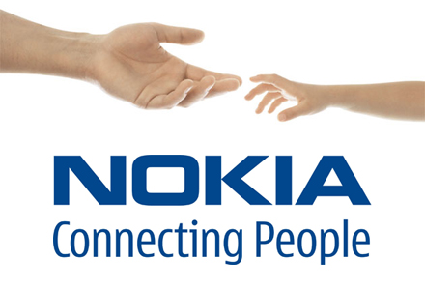
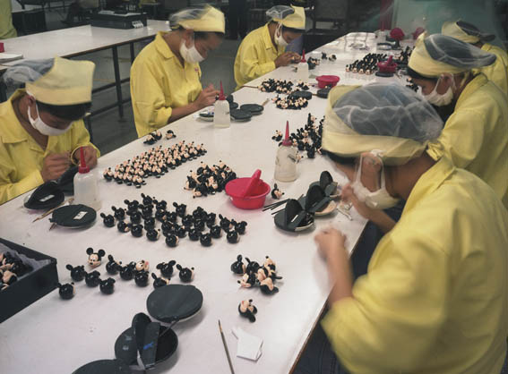
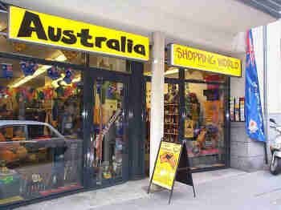

Slide 29
Limitations of SCM
HL
With increased globalization, international sourcing becomes more complex.
There are more partners, from various parts of the world, in the supply chain to deal with.
Time lags and potential conflicts can delay getting the right products to the right customers in a cost-effective way.
All suppliers in the supply chain are interdependent.
This means that a single problem can cause major disruptions.
The greater need for partners to share information and to collaborate also requires building trust among the partners.
Thus additional time and resources will be required.

