Slide 1
5.1 Production Methods
IB Business Management
01/02/15

Slide 2
Learning Outcomes
Describe and compare the features and applications of each method.
Analyse the implications for marketing, human resource management and finance that arise from changing the production system.
Analyse the most appropriate method of production for a given situation.
Understand the need for organizations to use more than one method of production.

Slide 3
Learning objectives
By the end of the lesson students should be able to:
Be able to define ‘Job Production’ and ‘Batch Production’
Understand how Job and Batch Production is used in modern business’
Advantages / disadvantages of each method – mainly linking to economies of scale and Quality

Slide 4
What is Production?
Input of Resources
Land
Labour
Capital
Enterprise
Add Value
Production Method
Output
Goods
Services

Slide 5
Production Methods
Job Production
A method of production where a product Is made individually from start to finish like a bridge. Each product is likely to be different and unique.
Batch Production
A method of production where a product is made in stages, with a particular operation being carried out on all products in a group or batch.

Slide 6
Job Production Examples

Slide 7
Job Production Examples
Only one can be made at a time
Huge combination of specialised labour and machinery working on it at once

Slide 8
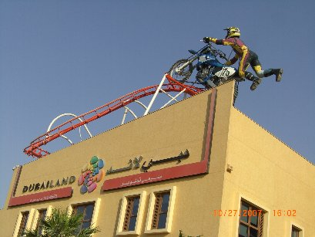
Job Production Examples

Slide 9
Advantages Disadvantages?
Think about
Quality
Price
Economies of scale
Flexibility of labour / business
Motivation
Uniqueness?

Slide 10
Advantages of Job Production
Motivation – variety and unique creation will motivate staff
Flexibility – can alter goods according to customer requirements
Uniqueness – Gives goods a USP – charge higher price as a result
Quality – labour intensity can ensure good quality

Slide 11
Disadvantages of Job Production
Few economies of scale – each good is likely to be unique so there is little scope to purchase materials in bulk
Long working-capital cycle needed to fund the long production process
Time Consuming
Mainly labour intensive

Slide 12
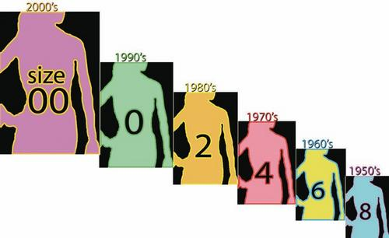
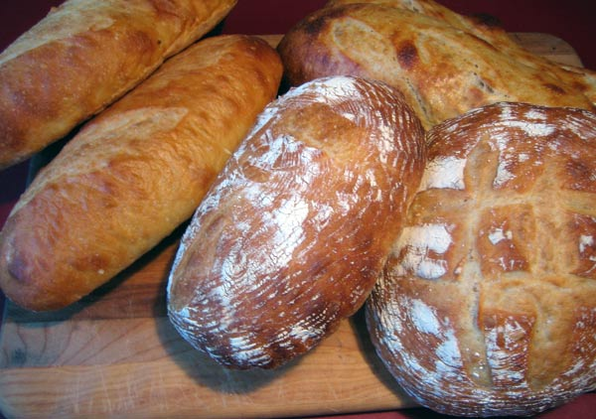
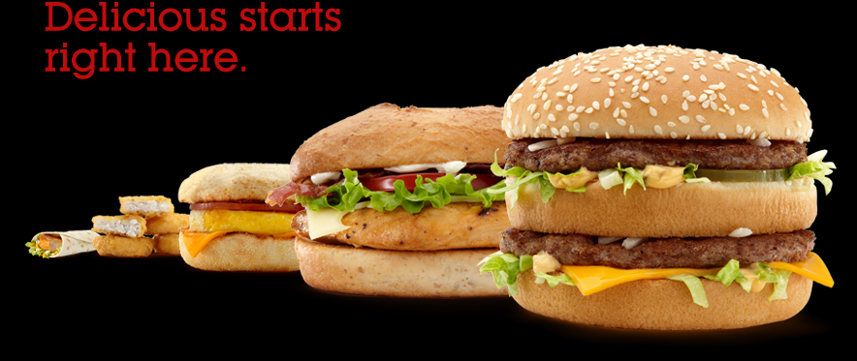
Batch Production Examples

Slide 13
Batch Production Example
http://www.youtube.com/watch?v=-VM20uKWn8g&hl=en&fs=1&color1=0x234900&color2=0x4e9e00

Slide 14
Advantages Disadvantages?
Think about
Quality
Price
Economies of scale
Flexibility of labour / business
Motivation
Uniqueness?

Slide 15
Batch Production Disadvantages
Inflexibility of waiting for one batch to finish
Storage of bulk-produced batches – costly
Boredom for staff – repetitive batches lacks variety
Advantages
Economies of scale – purchasing and technical
Specialisation – staff become more productive and quality becomes better

Slide 16
HWK – Bristol Cars Ltd
Page 616 – answer all questions
http://www.youtube.com/watch?v=ibUUts8-I0s

Slide 17
Bristol Cars Ltd
Bristol Cars Ltd is a producer of luxury cars, located in bristol UK. Each year, only around 100 cars are produced. Each car is unqiuely made allowing the firm to claim that the Bristol car is ‘Great Britain’s most exclusive luxury car’ The firm has no distributors or dealerships. Every part of a car is given the necessary time and attention to detail to satisfy both the client and the company. Only when each task is performed to perfection can the highly skilled workers move on to the next task. The cost of perfection means it can take a long time to produce each car, but Bristol Cars claims that ‘the car is produced for those who can afford and appreciate the best’
A) Describe the method of production used by Bristol Cars (4 Marks)
B) Examine the consequences of this production method for:
Bristol Cars
Employees of Bristol Cars
Customers of Bristol Cars (9 Marks)

Slide 18
Learning objectives
By the end of the lesson students should be able to:
Be able to define ‘Job Production’ and ‘Batch Production’
Understand how Job and Batch Production is used in modern business’
Advantages / disadvantages of each method – mainly linking to economies of scale and Quality

Slide 19
Learning objectives
By the end of the lesson students should be able to:
Be able to define ‘Flow Production’ ‘Line Production’ and ‘Mass Production’
Analyse the benefits and costs of mass/flow/line production
Apply the most appropriate method of production to given scenarios

Slide 20
Flow, Line and Mass Production
Terms tend to be used interchangeably:
Flow Production - a form of mass production whereby different operations are continuously and progressively carried out in sequence, e.g. producers of bottled water - http://www.youtube.com/watch?v=T8KJGtMGMSY&feature=related
Line Production – a form of flow, where the the product is assembled in various stages along a conveyor belt until a finished product is made - http://www.youtube.com/watch?v=S4KrIMZpwCY
Mass Production – manufacturing of large amounts of standardised product. Tends to be very capital intensive with high levels of productivity - http://www.youtube.com/watch?v=aYhEbjhhcAg&feature=related

Slide 21
Group Work – Analyse the Costs & Benefits of Mass/Flow/Batch
Advantages:
Capital intensive so production on mass scale so output is high and costs are low
Benefit from technical economies of scale – very little labour costs
Use of machinery means products are of a standardised quality so the consumer knows what to expect quality wise
Labour is very low skilled so wages are very low for business

Slide 22
Group Work – Analyse the Costs & Benefits of Mass/Flow/Batch
Disadvantages:
Work is very boring and motivation is very low
Any breakdowns will cause major problems for the business as it is an assembly line
Products are not tailored to individual customer needs – products are standardised so very inflexible once production process starts
Very expensive to start up with all of the machinery costs
Need a large storage space to stock mass production – cost of rent of this space

Slide 23
Explain the most appropriate method of production for each of the following
iPod
Mass/Flow production as it is a standardised mass market product sold globally – some alterations need to be made in terms of batch of colours but each style can still be mass produced as there is the demand for it

Slide 24
Explain the most appropriate method of production for each of the following
Wedding/Birthday Cakes
Job or Batch – Customers tend to want a unique cake for a unique day however they could purchase a batch produced cake and add final unique features to it

Slide 25
Explain the most appropriate method of production for each of the following
Cookies
Batch production as product is standardised but there needs to be different flavours for different consumer needs

Slide 26
Explain the most appropriate method of production for each of the following
Navy Battleships
Job production as the ships are highly expensive and sophisticated with unique features and capabilities. Infrequency of orders make it hard to make batches

Slide 27
Explain the most appropriate method of production for each of the following
Plasma Televisions
Mass/Flow – Standardised product that is sold in mass globally. Different batches of sizes can be made but each of these can be produced using mass/flow techniques

Slide 33
Key Terms
Job Production
A method of production where a product Is made individually from start to finish like a bridge. Each product is likely to be different and unique.
Batch Production
A method of production where a product is made in stages, with a particular operation being carried out on all products in a group or batch.
Flow Production
A method of production where a product is made continuously. Products are often manufactured using an assembly line. Mass produced goods are most suitable for this type of production.
Division of Labour
The specialisation of workers, where workers concentrate on performing a narrow range of tasks.
Specialisation
The breaking up of activities into separate parts or jobs. Each person carries out a specific job or task and becomes a specialist in it.

