Slide 1
Quality Control, Quality Assurance & Total Quality Management
IB BUSINESS
UNIT 5.4

Slide 2
Learning Objectives
By the end of this lesson, students should be able to:
Demonstrate understanding of different production methods being used in given scenarios
Analyse the benefits and issues a business may face in introducing quality systems
Demonstrate understanding of the various quality standards available to a company
Notes:
2

Slide 3

Types of Production Revision
Notes:
3

Slide 4
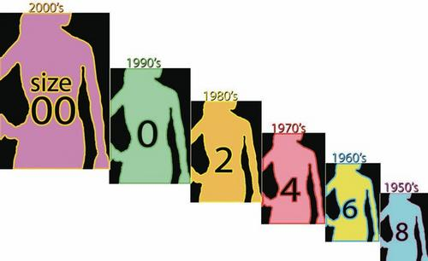
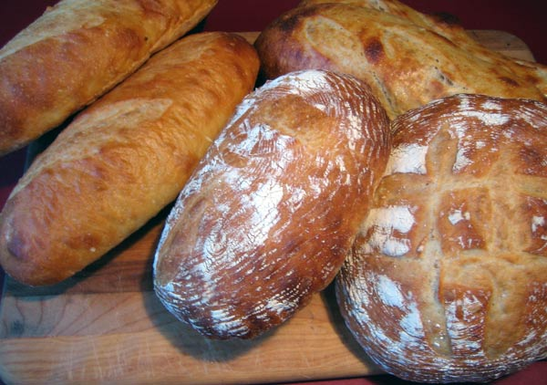
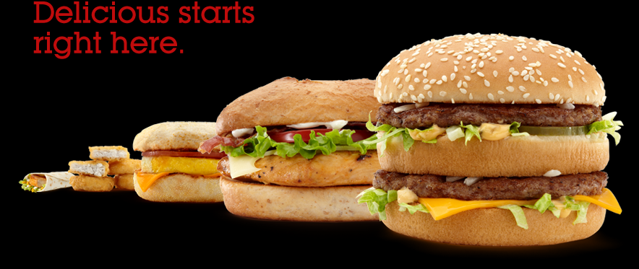
Types of Production Revision

Slide 5





Types of Production Revision

Slide 6


Types of Production Revision
Only one can be made at a time
Huge combination of specialised labour and machinery working on it at once

Slide 7

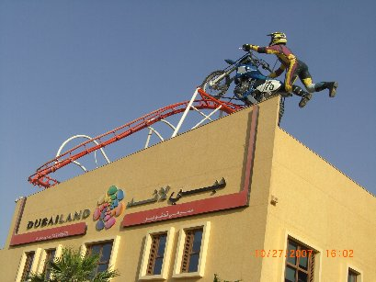
Types of Production Revision

Slide 8

Types of Production Revision

Slide 9
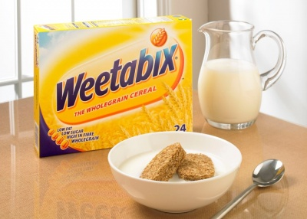
Types of Production Revision

Slide 10
Quality – How do we measure it?
http://www.youtube.com/watch?v=LApWU34o0eY
http://www.youtube.com/watch?v=EHFKE6PD_6U

Slide 11
Methods of maintaining Quality
Quality Control – A traditional way to make sure that products went out of factories with no defects was to have Quality Control departments whose job it was to take samples at the end of production at regular intervals to check for errors. If errors were found then a whole batch of production might have to be scrapped or reworked.

Slide 12
Methods of maintaining Quality
Quality Assurance – the management process of guaranteeing the customer of a product’s quality. It informs customers that all products have been made to the required specification and that certain quality standards have been met. This can be an important source of competitive advantage for a business. Quality assurance is more concerned about preventing poor quality output rather than rectifying it. Therefore, a key focus of quality assurance is product design and development, which is checked at EACH stage of the production process

Slide 13
Methods of Maintaining Quality
Total Quality Management (TQM) – both have become very popular in business
TQM – A culture of quality that involves all employees who must adopt a target of ‘right first time’ and ‘zero defects’ in their production. In this way every department contributes to the quality of products at each stage of production and are constantly trying to improve

Slide 14
Benefits of Having a Quality Control System
Impacts on Sales Positively
Creates a USP – Can advertise your quality system
Impact on Selling Price – Can increase it if products perceived to be quality
Cost Reductions – e.g. Waste is reduced, not as much repair needed
Reputation Improved – e.g. Cadbury’s reputation in 2006 was damaged by negative publicity concerning a salmonella scare

Slide 15
Quality Control Problems – Is it always an effective method?
Have a look at some of these cases…

Slide 16
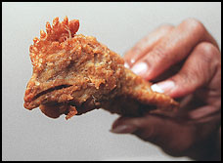
Quality Control Problems
http://www.youtube.com/watch?v=I4peC31MgLE

Slide 17
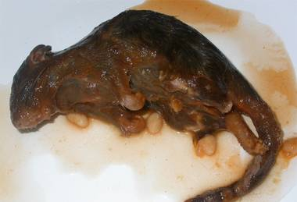
Quality Control Problems
http://www.independent.co.uk/life-style/food-and-drink/news/rat-found-in-tin-of-baked-beans-2069687.html

Slide 18
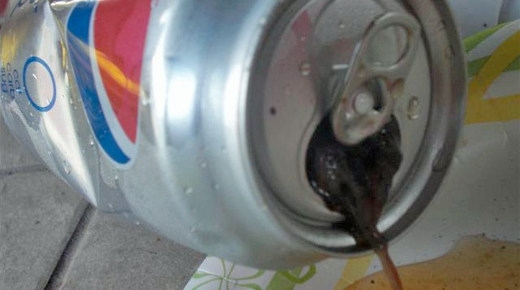
Quality Control Problems
http://newsone.com/nation/news-one-staff/couple-says-they-found-mouse-in-can-of-pepsi/

Slide 19
Problems Involved in having a Quality Control System
Not all products are checked so there is still a chance that defect products will end up with customer
Costs – Quality monitoring costs money
Training – To keep up quality, staff must be well-trained to implement the quality system. Training can be very costly
Disruption to Production – workers may be taken off production line in order to be trained or check quality at different times – more mistakes will happen too with workers moving in and out

Slide 20
Quality Assurance – Ways to avoid Quality Control Problems
This involves inspection being carried out during the production process in order to prevent poor quality products from completing production.
It is an aim to maintain quality throughout an organisation – it is also referred to as TOTAL QUALITY MANAGEMENT (TQM)

Slide 21
Features of TQM
Quality Chains – every worker in a business is like a link in a chain – production will not carry on semi-finished work until it has been inspected and has reached a specific quality standard
Everyone is involved – every department, activity and worker is organised to take into account quality at all times
Teamwork – TQM stresses that teamwork is the most effective way of solving problems

Slide 22
Features of TQM
Quality Audits – Data is used to monitor quality standards
Customer Focused– firms using TQM are committed to their customers. They respond to changes in people’s needs and expectations
Zero Defects – Many quality systems have a zero defect policy. This aims to ensure that every product that is manufactured is free from defects

Slide 23
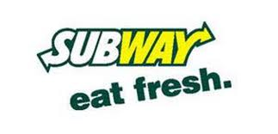
TQM Case Study - Subway
http://www.youtube.com/watch?v=F3hz37CqBKM&feature=related
http://www.youtube.com/watch?v=npDksBFa6sI&feature=related

Slide 24
TQM Case Study - Subway
Subway has recently become the market leader, ahead of McDonalds, in the number of outlets worldwide. Their TQM is one of the secrets to their success – they even have a dedicated section on their website for customers to comment on their experiences at Subway, which helps the firm to gain customer feedback to further improve its quality standards.
Task – In your groups, analyse the possible advantages and disadvantages of TQM to Subway as a global franchise

Slide 25
Possible Answers – Subway Case Study
Advantages:
Waste and inefficiencies are removed
Can keep Subway competitive against giants such as McDonalds, Burger King and KFC
Gives them a good reputation for quality – gives them USP
Can improve staff motivation as they are proud to work for a quality, reputable firm
Can therefore attract new people to start a Subway franchise
Disadvantages:
Hard to keep TQM throughout its global franchises – hard to oversee every single one keeping the same TQM standards
To train every staff member will take time and cost money
May be difficult for Subway to respond to every customer complaint with so many, and so many stores
Will require everyone to be committed – difficult to get 100% support from all staff

Slide 26

Wipeout
Challenge!
Quality Assurance & TQM
Notes:
Wipeout Challenge: See Notes View on how to use this game
Game objective: The winning team is the one with the highest points!
How to play:
Using any method you wish (e.g. Drawing straws) to determine which team goes first.
This team chooses the first answer that they think is correct (for the question posed at the bottom of the screen. The games master then clicks on the teams answer. If they are correct they will get a ‘star’ symbol. If the team is incorrect they will get the big ‘W’ symbol.
If the team are correct they can choose to pick another answer or pass that responsibility to the next team (going clockwise).
Scoring:
The team scores points based upon the number of correct answers already given – the 1st star on the board brings 10 points, the 2nd brings 20 points and so until 110 points is given for the 11th correct answers. (See guide at the side of the screen)
If the team gives an incorrect answer (gets a big ‘W’) then their entire score is ‘wiped’ out.
The scoring accumulates between the 3 games but can also be wiped out at any point (teams can not bank points from one game to another.
If all 5 incorrect answers are found, then the game ends and the games master can move on to the next game (if there is one!)
Editing:
To edit answers, click on any individual square and change text. The incorrect answers (wipeouts) are signified by the red crosses (which don’t appear when you run the slide show).
Tip:
Use the final slide of this presentation to show the accumulated scores. Print off as many of the final slide as you need for the number of teams. Laminate the card (if you can) and then the teams can add or wipe out as required.

Slide 27

(1) Right first time
(2) Uses inspectors only at the end of the process
(3) Takes responsibility away from the workers
(4) Empowers employees
Values
1
10
2
20
(5) Increases a firms direct labour costs
(6) Quality standards need to be agreed
(7) Everyone responsible for quality
(8) Workers may not welcome extra responsibility
3
30
4
40
5
50
(9) Can meet workers esteem needs
(10) Quality checked only at the end of the process
(11) Need to spend money on staff training
(12) May slow down production when first implemented
6
60
7
70
8
80
9
90
(13) Possible staff resistance
(14) Can improve staff motivation
(15) Does little to encourage staff to improve quality
(16) Increases workers responsibility
10
100
11
110
Which are features of TQM?
Next

Slide 28
Learning Objectives
By the end of the lesson, students should be able to:
Apply Quality Assurance & TQM to real-world business (All)
Understand the various other Quality Standards businesses can use to maintain quality

Slide 29
Lesson 3 – TQM & Quality Standards
McDonald’s website and in-store information posters for customers state that:
Only 100% beef is used without additives
Only prime white fish is used
Only chicken approved by the national authority of food safety is used
Only the freshest eggs are used. These are washed and sanitized to remove dirt from the shells
Only the Russet Burbank potatoes are used to generate French fries (chips) that are fluffy inside and crispy outside

Slide 30
McDonald’s Case
http://www.youtube.com/watch?v=N2diPZOtty0
Task
1) In your groups, think of which type of quality standard they are trying to now do after ‘SuperSize Me’ gave them such bad P.R.
2) List reasons why you think McDonald’s feel it is important to have these quality standards now?

Slide 31
McDonald’s Case – Possible Answers
Total Quality Management– Ensuring quality at all stages and batches of their production & using customer feedback to help - http://www.mcdonalds.com/us/en/contact_us/restaurant_feedback.html
2) Increased competition has forced them to improve quality – Subway now overtaken them as largest fast food outlet (volume) in the world. Consumers no longer need to buy products from businesses that fail to deliver quality
Government legislation designed to protect consumers has forced firms to improve quality, especially with food.
Faulty products are costly for businesses – can harm reputation as we have seen
Overall sales will be affected as customer demands quality and value for money these days – especially health wise

Slide 32
Quality Standards
Quality Standard – A set of criteria for quality established by an organisation. The standard also requires an organisation to have systems for implementing and monitoring its standards
BS 5750 – A British Standards award granted to organisations that possess quality assurance systems that meet the standards set
ISO 9001 – The international standard of quality assurance that is equivalent to BS 5750

Slide 33


‘KiteMark’

Slide 34
KiteMark Quality
Products that carry the Kitemark are inspected regularly to ensure that they are maintaining quality standards.
BSI, Kitemark, and ISO are all measures of quality for an organisations products and services. This gives the consumer confidence in purchasing these goods
Notes:
34

Slide 35


Example of Quality Standard with Food: Organic vs GMO

Slide 36
Kaizen
Use more technical machines
Produce more goods
Lean Production
Values
1
10
2
20
Buy goods from Cheap Suppliers
Quality Control
Zero Defects
Kitemark
3
30
4
40
5
50
BS 5750
Gives staff less responsibility
ISO 9001
Teamwork
6
60
7
70
8
80
9
90
Total Quality Management
(14) Can improve staff motivation
Encourage customers not to feedback their feelings on the quality of goods
Quality Assurance
10
100
11
110
What measures can a company take to maintain Quality?
Next

Slide 37
Learning Objectives
By the end of the lesson, students should be able to:
Apply Quality Assurance & TQM to real-world business (All)
Understand the various other Quality Standards businesses can use to maintain quality

Slide 38
Kaizen – Continuous Improvement
HL
Is the Japanese word for a philosophy of continuous improvement.
Consists of two parts:
  Kai → meaning “change”
  Zen → meaning “good”
The process involves forming small groups of employees (known as Kaizen Groups) whose role is to identify changes and improvements to the organization’s products, processes, and procedures.
  Aim at establishing a steady flow of small improvements.. WHY?

Slide 39
Benefits of Kaizen
Focus on continual quality improvements.
Eliminates waste by looking at ways to improve productivity and efficiency of the firms operations.
Encourages small-scale suggestions from anyone in the organization.
Motivates staff due to the empowerment of decision making.

Slide 40
Quality Circles
HL
Introduced by Professor Ishikawa in 1962.
“Refers to small groups of people who are organized together
to examine issues relating to the quality of output and to make recommendations for improvement to management.”
  QC are better empowered to put their ideas for improvement into action (more decisions making power) & are involved in the implementation and management of the solution.

Slide 41
Continued…
HL
Advocates of Quality Circles emphasize the importance of team cohesiveness in managing and improving quality.
Ultimate benefits of Quality Circles and Kaizen are increased efficiency, productivity, and profitability.
A huge limitation to Quality Circles and Kaizen is that many individuals remain motivated by team working, extra responsibility, or empowerment.

Slide 42
Benchmarking
HL
“Refers to a business comparing its products, operations, and processes to those used by others in the same industry, especially market leaders.”
The purpose is to allow the business to follow best practice (excellent performance) in order to improve its operational efficiency.

Slide 43
Benefits of Benchmarking:
HL
Allows a business to close the performance gap.
Dealing with problems of quality by using external benchmarking can be quite fast and is more effective.
Looks at comparisons from the perception of customers, thus providing better customer satisfaction.
Can help lower production costs and improve overall competitiveness.
Considered as a continuous process with the involvement of employees → increase in quality!

Slide 44
Limitations of Benchmarking:
HL
Cost and time needed to collect relevant and up-to-date information is expensive.
Relying on replicating the ideas and practices of other firms may be seen as second best.
Can discourage initiative and innovation ideas.
Sufficient time and finance must be made available to implement the findings of the benchmarking analysis.

