Slide 1
5.6 Innovation (HL)
IB Business Management
Unit 5

Slide 2
5.6 Innovation - Learning Outcomes for Exam
Explain the importance of R&D for a business.
Explain the role and importance of intellectual property rights for a business.
Analyse the factors affecting innovation.

Slide 3
Key Terms
Invention
Formulation of new ideas for products and processes.
Innovation
Practical application of new inventions into marketable products or services.
Patent
The legal right to be the exclusive producer or user of a newly invented process or product, for a finite period of time?
Copyright
Provide legal protection for artists and authors.
Trademarks
A sign or logo that represents a business or a product belonging to that business.

Slide 4
R&D and Innovation 5.6 HL
Benefits of R&D
Can lead to improved performance of an organisation
Can lead to higher sales growth
Value added likely to improve
There is a possibility of increased market value
It can give a business first mover advantage

Slide 5
Factors Affecting Innovation
HL
There are two main/ general sources of innovation:
Manufacturer innovation
Occurs when a person or a business commercializes their invention or discovery.
End-used innovation
Occurs when a person or a business innovates for their personal use because there are no existing products that meet their needs or wants

Slide 6
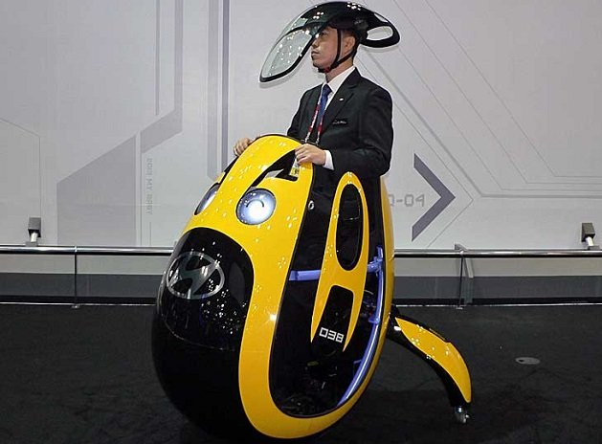

Slide 7
Drucker’s Seven Sources of Innovation
The Unexpected – Coke’s huge sales of diet coke led to introduction of Coke Zero
Weaknesses to production – airline tickets were very complicated process so inventing e-ticketing made ques at airport less and easier for people to purchase travel
Strangeness – are there any differences between what people believe and reality? – E.g. selling ‘no added sugar foods’ as ‘low calorie’ in consumers eyes

Slide 8
Drucker’s Seven Sources of Innovation
Market Structure – Are there any changes to supply and demand in market, e.g. pressure groups becoming health conscious over fast-food has led to healthier menus
Demographic Changes – changes in population size and age can influence new products
Changes in Perception – businesses are now more socially conscious due to public awareness
New knowledge – technological knowledge has led to introduction of e-commerce

Slide 9
Dyson - Innovation
http://www.youtube.com/watch?v=AMgeNjXtYx4
http://www.youtube.com/watch?v=PzCU7fiTXEw

Slide 10
Innovation at Dyson
Why is new product development and launch so important to firms like Dyson?
Why are patents important to Dyson?
How does the use of prototypes help manage risk?
Why is it important for Dyson to understand it’s market?
What is the role of design and technology in the manufacturing process?

Slide 11
Nintendo Case
Nintendo allocated $200 million just to the innovation and creation of the Wii
1) Comment on the importance of innovation in a rapidly changing industry, such as the games console market (4 Marks)
2) Analyse the factors that affect the degree of innovation in a business such as Nintendo (6 Marks)

Slide 12
1)
Important to keep pace with rivals Sony and Microsoft
Could get First mover advantage
Games consoles have short life cycles therefore important to survive
Will get consumers attention and give competitive advantage – will gain brand loyalty as the 250,000 customers on a waiting list to buy because it is Nintendo

Slide 13
2)
Benchmarking – who is the top competitor in the market to compete with? What are their best innovations to model off?
Stage in product Life Cycle – Wii is in the decline stage in terms of sales so Nintendo needs to innovate a new product to replace
Finance Available – how much capital is there to budget for innovation? In this case quite a lot - $200 million
Firms market share – low market share may mean desperate need to innovate
Risk of investment – can the business afford to innovate?
Quality of workforce – Does the firm have the skills to innovate enough to stay competitive in the market?
Speed of Change in industry – how important is continuous innovation in that particular market? It is very important in this particular market as it says in the case that this market changes technology in short amount of time these days
Market Orientation VS Product Orientation – Take a risk or wait to see what consumers want?

