Slide 1
5.7 Stock Control & Production Planning
IB BUS MGT
SL

Slide 2
5.7 Production Planning – Exam Expectations
Recognize the need for optimum stock levels; prepare and analyse appropriate graphs.
Explain different stock control methods and analyse the appropriateness of each method in a given situation.
Explain outsourcing and subcontracting.
Discuss the arguments for and against outsourcing and subcontracting, compared with provision by the firm itself.
Make appropriate calculations to support a decision to make or buy.

Slide 3
Stock Control
Stock control: “involves careful planning and monitoring to ensure that sufficient stocks are available at the right time.”
Stockpiling: “occurs when a business builds up excessive stock.”
Stock-out: “when a business doesn’t hold enough stock to meet orders”

Slide 4
Costs of holding stock:
Storage costs , such as rent, insurance, and security.
Storing large volumes of perishable goods may be expensive and wasteful.
Stock can be illiquid so it is ties up working capital which could have been used elsewhere.
Changing fashion and tastes will mean that excess stocks will need to be heavily discounted in order to offload the products.

Slide 5
Cost of holding insufficient stock:
Lost sales since stock are not available to meet customer orders.
Halted production due to insufficient stock.
Damaged corporate image and reputation due to upset customers.
Higher costs since staffing costs still need to be paid.
Higher administration costs will be incurred as the firm places more orders more often.

Slide 6
Just-in-case (JIC)
“Is the traditional stock management system that recognizes the need to maintain large amounts of stock in case there are supply or demand fluctuations.”
Example: Amazon at Christmas…
http://www.youtube.com/watch?v=Z2Bs0nqVyqs
http://www.youtube.com/watch?v=gcXoj_UBXv8

Slide 7
Advantages of JIC
Allows a business to meet sudden changes in demand.
Increased flexibility due to having sufficient stock (of inputs such as raw materials or component parts) enables the firm to speed up production if necessary.
Allows a business to take advantage of purchasing economies of scale.
Reduces downtime caused by a stock-out (lack of stock).

Slide 8
Drawbacks of JIC
The same as “costs of holding stock”.

Slide 9
Just-in-time (JIT)
“Is a stock management method based on having stocks delivered as and when they are needed in the production process.”
Example: Car manufacturing

Slide 10
Advantages of JIT
Reduces the cost of holding stock, such as: rent and insurance.
Since there is minimal money tied up in stock, working capital can be better used elsewhere which improves cash flow
Allows firms to be more flexible and responsive to the needs of their customers.
Can improve motivation in the workplace by promoting employee participation and team working.
It can reduce waste (ex: perishable goods + “right first time”).
Can strengthen a firm’s relationship with its suppliers, thus reducing lead times in production processes.

Slide 11
Limitations of JIT
Huge reliance on external suppliers
Minimal stock levels mean that there is little room for mistakes.
Often proves to be inflexible when it comes to coping with sudden changes in demand.
Fewer opportunities to exploit purchasing economies of scale.
Administration costs will be higher due to frequent ordering.
No time for quality control.
Relies on sophisticated computer technologies to ensure that the correct stocks are ordered and delivered.

Slide 12
Traditional Stock Control
HL
A system that uses a purchasing department to take charge of stock control.
The roles of the traditional purchasing department included:
Purchase good quality raw materials, component goods, and other supplies at competitive prices.
Ensure that the right quantity and quality of products are available for production.
Arrange for timely delivery of stocks to ensure that they are available for production.
Develop good professional relationships with suppliers.

Slide 13
Stock Control
Stock Level
Maximum Stock Level
Re-order triggered
Re-order level
Minimum Stock Level
Lead Time
Time
When the stock level reaches the re-order level, it triggers a new order. The difference between the time of re-order and delivery is the ‘lead time’.
Maximum stock levels achieved after stock delivery. Stock levels decline during production.
The Traditional Stock Control Model

Slide 14
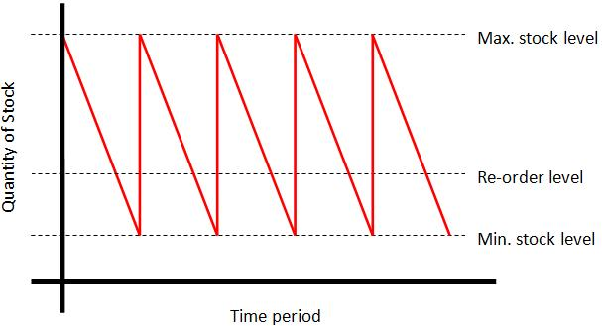
Stock Control Charts
HL
Are used to graphically illustrate a simplistic system of stock control.
The diagram assumes that sales are constant.

Slide 15
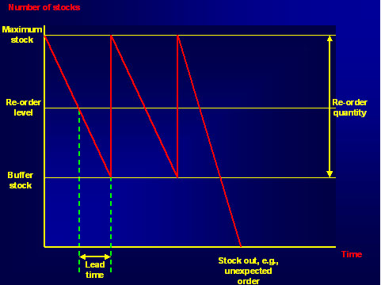
Stock Control Diagram

Slide 16
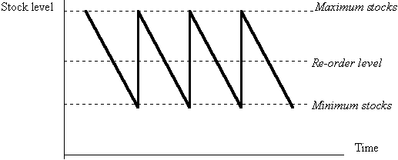
Stock Control Diagram

Slide 17
Maximum Stock

Slide 18
Over time the amount of stock falls

Slide 19
Stock needs to be reordered before it runs out

Slide 20
More stock gets used up

Slide 21
The minimum level of stock is reached

Slide 22
More stock is delivered (hopefully)

Slide 24
The time between ordering stock and delivery is known as lead time

Slide 28
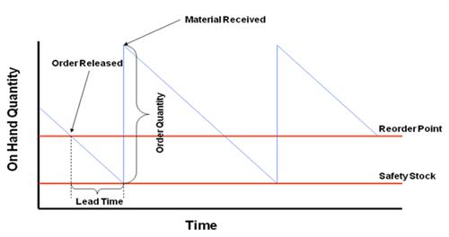
Continued…
HL
Stock control charts can help businesses with their management of stocks.

Slide 29
Continued…
HL
Important features of the stock control chart:
Maximum stock level – Upper limit of stock that a business wishes to hold. This is determined by the physical storage space and level of demand.
Reordered level – Time lag between a firm placing an order for stocks and it being delivered. Ensures ordered are delivered before stocks fall to below minimum levels.
Minimum stock level – Smallest amount of stock that a business wishes to hold.

Slide 30
Continued…
HL
Buffer stock – Minimum stock level held by a business in case there are any unexpected incidents.
Reorder quantity – Amount of new stock ordered.
Lead time – Measures the amount of time between placing an order and receiving the stock. The greater the lead time, the greater the buffer stock.
Usage rate – Speed at which stocks are exhausted.

Slide 31
Optimum Level of Stocks
HL
Economic Order Quantity: “The optimum level of stocks which ensure that there are sufficient stocks of production to take place without any interruptions, with minimum costs.”
Factors influencing the amount of stocks a business holds:
Type of product
Forecast level of demand
Lead times
Costs of stockholding
Electronic Point of Sale (EPOS): “Computerized systems that automatically keep a running balance of stock levels and reorder them when necessary.”
Spot Checks: “Manual stock control by staff.” (damaged + stolen stock)

Slide 32
Capacity Utilization
HL
“Measures the existing level of output of a firm as a proportion of its total potential output.”
A high level of capacity utilization means that the output levels are close to their maximum level (AKA. Productive Capacity), per period of time.
Capacity Utilization = (Actual Output/Productive Capacity) x 100
Ex: a firm’s maximum possible output is 10,000 units per month but it actually produces 8,500 units per month → capacity utilization is 85%.

Slide 33
Continued…
HL
High capacity utilization is likely to be relatively more important to firms that have:
High fixed costs
Low profit margins
High levels of break-even
Low marginal costs
Drawbacks of high capacity utilization:
Machinery are used constantly thus no time for routine servicing and maintenance leading to breakdowns and delays in output = DEFECTS
Leads to stress being placed on workers = DEMOTIVATION
May lead to problems such as waiting lines and overcrowding

Slide 34
Outsourcing/Subcontracting & Offshoring
HL
Ways a business can strive to gain a cost advantage:
Offshoring: “an extension of outsourcing that involves relocating business activities and processes abroad.”
Outsourcing/Subcontracting:
“Refers to the practice of transferring internal business activities to an external firm as a method of reducing costs.”
Used usually for thee interrelated reasons:
When activities are not core to the functions of the business.
When the business lacks the specific skills.
To cut costs of production.

Slide 35
Advantages of Outsourcing
HL
Specialists are hired to carry out the work to high quality standards.
Different subcontractors will bid (or tender) to carry out the outsourced work, thus work is done through competitive prices.
Helps reduce labor costs.
Allow a business to concentrate on its core activities.
Improves workforce flexibility (ex. Recruitment levels)
Off shoring (contracting out production facilities to overseas organizations) helps a businesses get around protectionist measures set by governments.

Slide 36
Disadvantages of Outsourcing
HL
Will cause redundancies that effect the level of morale and motivation within a firm.
Subcontractors need to monitored to ensure that deadlines are met and quality standards are observed, thus administration costs will increase.
Outsourcing and offshoring have often been associated with ethical concerns and problems.
Quality management becomes more difficult.
The benefits of offshoring are subject to the external environment .. Ex: exchange rates, economic situations.

