Slide 1
CPA EXAM QUESTIONS
5.8 HL CPA

Slide 2
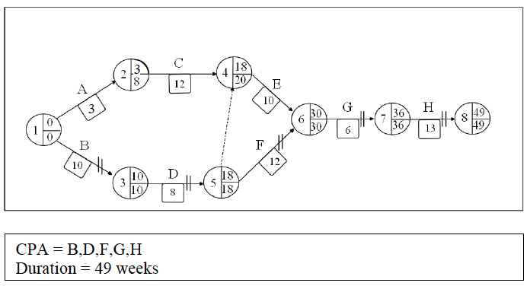
PMG QUESTION 1

Slide 3
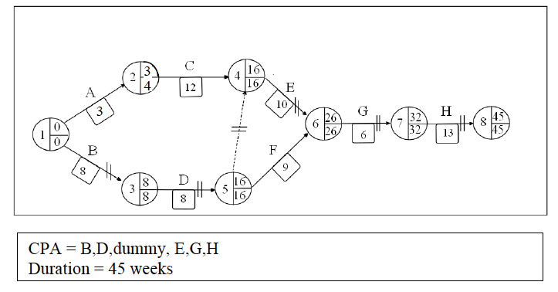
PMG Q2

Slide 4
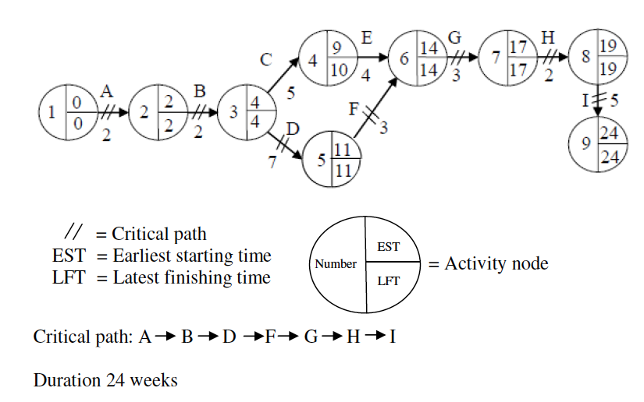
Esperanto

Slide 5
(ii) Implications of Total Float
Activity C can be delayed by 1 week without impacting on the critical path and the project can still be completed in 24 weeks.
If a delay occurs on any of the activities on the critical path that have 0 total float, the management can transfer resources from either C or E to those activities, provided a delay in any of the activities will not exceed 1 week.
If activity C or E is completed within 5 weeks, then labour could be transferred to other tasks for the float week to ensure other tasks on the critical path are completed on time.

Slide 6
(iv)
see a visual display – the diagram clearly illustrates and hence makes it easier to follow the type/nature of the activities, the order of activities and the dependency between some activities so that the marketing and product launch can be completed
see those activities, which are critical and must be completed without delaying the marketing and product launch
identify float time on the network so that resources can be transferred from non-critical activities to critical activities with no overall impact on the duration.

Slide 7
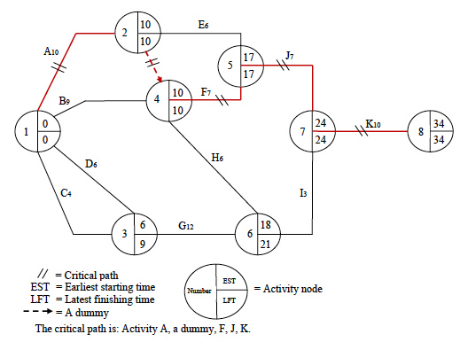
SOLID CONSTRUCTION

