Slide 1
USING YOUR CALCULATOR MUCH EASIER!
After all this tedious work, now there is a shortcut→ your MAGIC Calculator

Slide 2
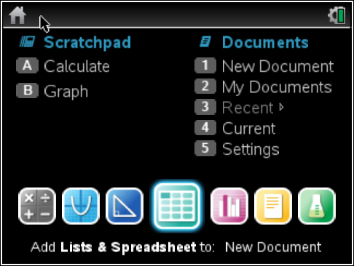
If data is given as a list
5, 6, 7, 10, 5, 4, 7, 6, 8, 10
1st step: Enter data in GDC→ go HOME and pick
List and spreadsheets
Enter a title for column A
and then enter your data.
(refer to the next slide)

Slide 3
Enter your data, like you would in a “xcell”

Slide 4
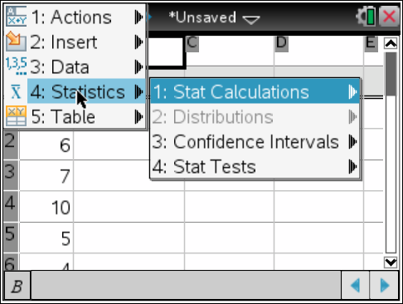
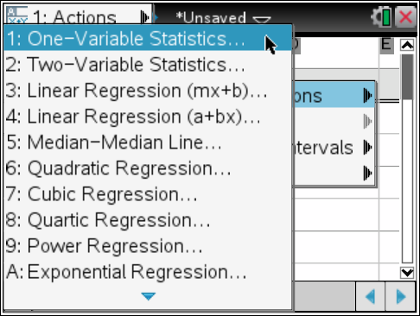
Go to Menu→4:Statistics→Stat Calculations→1:One-Variable Statistics

Slide 5
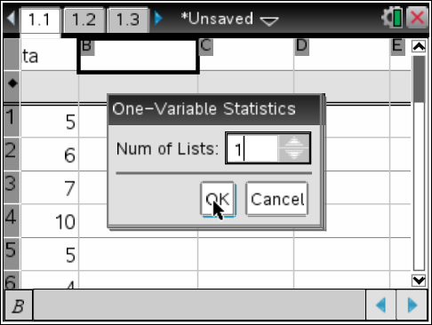
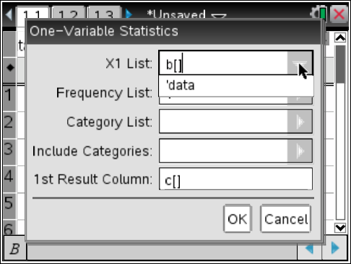
Usually, you will only analyze one variable in one
IB question, hence keep Num of lists to 1
X1 List: choose your data
It is easier if you go to the
arrow
Click OK

Slide 6
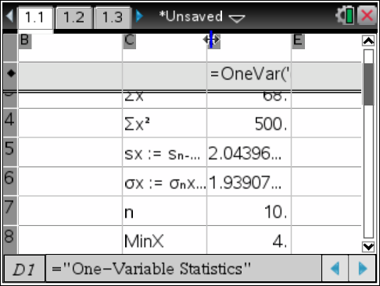
Your spreadsheet will now show the results.
Make sure you scroll down to get to standard deviation.

Slide 7
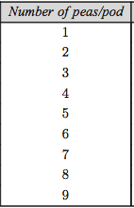
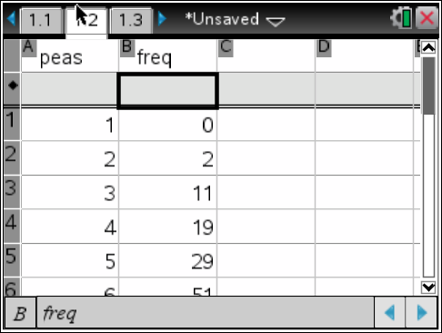
Frequency Table

Slide 8
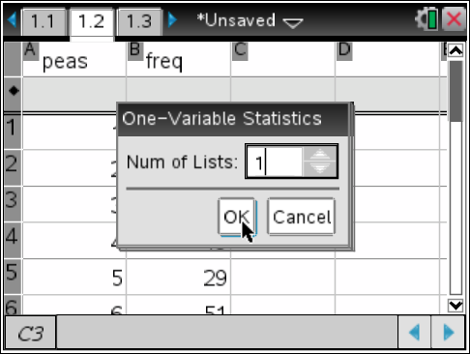
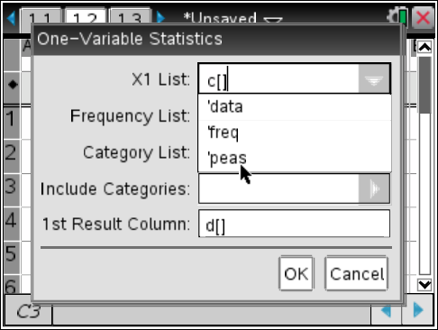
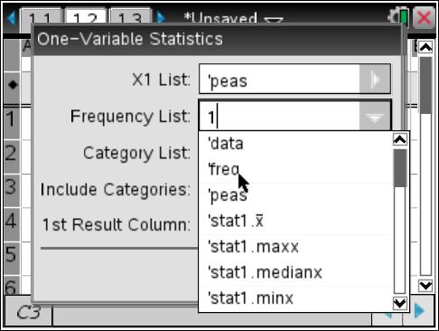
Now go to menu→stats→Stats Calculations→1 variable
Don’t forget to now choose a frequency
Column. Otherwise, you are not taking
Into account ALL the elements of your
Data.

Slide 9
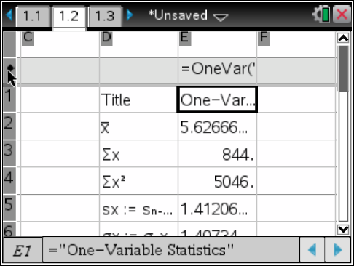
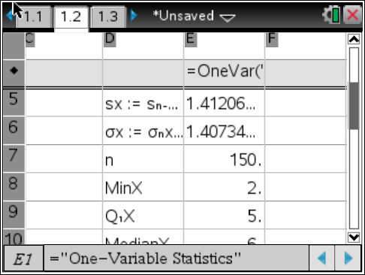
Voila!!!
Scroll down for results
Since n = 150, I know
I did enter my frequency

