Slide 1
Leadership & Management
IB BUS MGT 2.4 SL
28/2/2014

Slide 2
Lesson objectives
By the end of the lesson, students should be able to: -
Define the roles of leader / manager and be understand the generic differences
Identify the key differences between the modern and the traditional managers.

Slide 3
Lesson objectives
By the end of the lesson, students should be able to: -
Define and analyse the 4 key leadership styles
Autocratic
Democratic
Laissez-Faire
Situational Leadership

Slide 4
Difference between managers and leaders?
It is a question that has been asked more than once and also answered in different ways. The biggest difference between managers and leaders is the way they motivate the people who work or follow them, and this sets the tone for most other aspects of what they do.
Many people, by the way, are both. They have management jobs, but they realize that you cannot buy hearts, especially to follow them down a difficult path, and so act as leaders too.

Slide 5
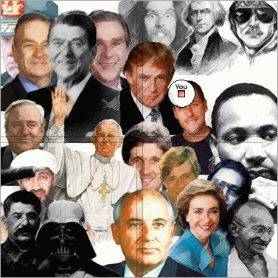

Slide 6
Difference between managers and leaders?
Leadership is the process of influencing and inspiring others to achieve a goal, from completing a task to achieving a corporate objective (Hoang 2008).
Management is about problem solving based on reasoning, rather than emotions.
“The art of getting things done by people” (Mary Parker Follett, 1868- 1933)
The process of planning, organising, and coordinating human and capital resources of a business to achieve the organisational objectives.

Slide 7
Difference between skills and roles of managers
Management | Leadership
Do things right | Do the right thing
Doing what is right | Knowing what is right
Directing and controlling others | Motivating and inspiring
Delegating tasks to subordinates | Empowering followers
Follow orders from senior execs | Inspire others to follow shared vision
Confirm to the norms of the business | Create and foster a change culture
Problem solvers | Innovators
Official position of responsibility | Traits within people, irrespective of rank
Position | Action
Planning, directing and monitoring | Strategic decision making
Listening to others | Respected, appreciated, liked, trusted
Achievement of objectives through compliance of others | Achievement of objectives through acceptance and willingness of others
Analysis | Decisiveness
Learned skills | Natural instincts
Organisation of staff | Support and guidance for followers

Slide 8
Henry Mintzberg
Mintzberg disputed that management roles were about planning, organising, monitoring and controlling, instead he argued a managers main function was:
Interpersonal roles: Leader role, Figurehead role, Liaison role.
Information role: Communication channel between departments.
Decision making role: Tactical and strategic decisions made by managers
Managers tasks include: -
Routine tasks: attending meetings
Planning tasks: timetabling and preparing of daily tasks.
Communication tasks: sharing and passing on information.

Slide 9
Modern leadership versus traditional
Modern management thinking suggests that to get the best out of the workforce, people need to be led, rather than simply managed as subordinates. People like Sir Richard Branson try to do this by inspiring their people to gain their loyalty and commitment.
Ken Blanchard (author) suggests that “effective managers offers support and encouragement rather than act as an evaluator or critic of their subordinates.”

Slide 10
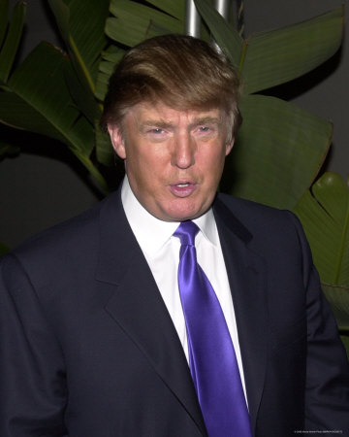
Donald Trump
Donald Trump is the CEO of the Trump Organisation and the host of the highly successful TV show The Apprentice. He has a diverse portfolio of businesses, which include: real estate, hotels, casinos, restaurants, bottled water, vodka, ice cream and golf courses. Trump is often reported in the press as being an outspoken and flamboyant leader. His high profile makes him one of the highest paid public speakers in the world, demanding up to $1 million for each lecture
1) Explain why Donald Trump might be classed as an effective leader (4 marks)

Slide 11
Why is Donald Trump an effective leader?
Effective leaders are those that inspire and guide people to achieve their objectives
Trump has proven to be a highly successful entrepreneur with his diverse ‘portfolio of businesses’
He has succeeded in leading the Trump Organisation in diversifying from real estate to a huge range of different products (e.g. golf courses).
His ‘high profile’ are indicative of his leadership qualities

Slide 12
Autocratic
Makes all the decisions and prefers not to delegate any responsibility. The leader simply tells people what to do.
This is suitable in situation where quick or critical decisions need to be made.
The communication is top down so there is no opportunity for feedback, this can make staff feel alienated and de-motivated.

Slide 13
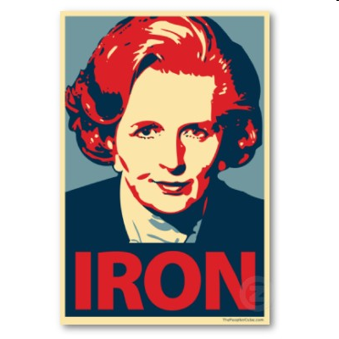

Slide 14
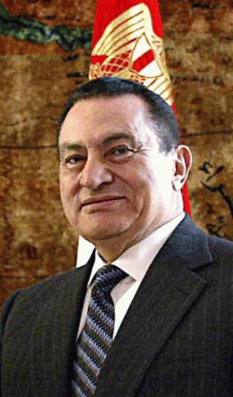

Slide 15
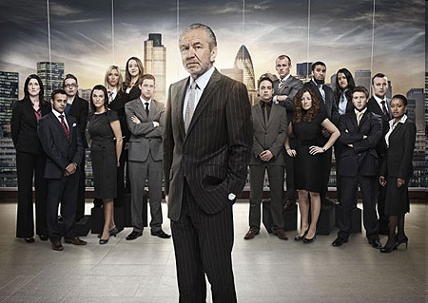

Slide 16
Autocratic & Paternalistic

Slide 17
Autocratic & Paternalistic

Slide 18
Democratic
This leader prefers to discuss and involve employees in decision making
This leads to better morale. This method is useful if the manager is not always around to make sure workers are on task.
Decision making can take a long time due to more people being involved, in addition it would be unsuitable if there is a very large workforce.

Slide 19
Laissez-Faire
The leader has minimum direct input into the work of the employee.
They leave subordinates to make their own decisions and to complete tasks in their own way. Can lead to very high staff motivation. Good for creative businesses.
Can encourage slack from workers.

Slide 23
Situational Leadership (contingency management)
This style, unlike the others, is not based on any single approach to
leadership because employees are all different in so many ways.
It uses the right person and the right style for the right situation.
Situational leadership suggests that managers and leaders must be
able to change and adapt to different situations. CLOTS.
Culture
Leader
Organisation
Task
Subordinates
CLOTS represents an easy way to remember the factors that may affect situational leadership styles

