Slide 1
Coca Cola’s Happiness Machine
Pecha Kucha

Slide 2
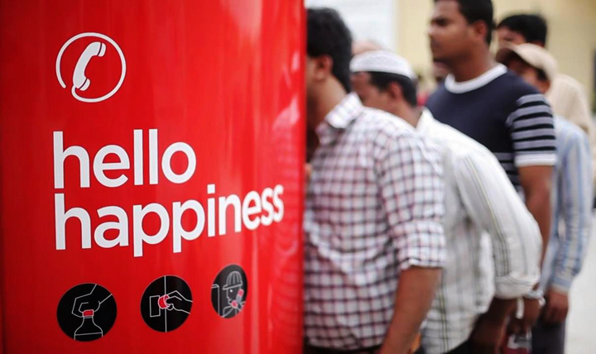
Coke Creates Phone Booth
Coke creates a phone booth that accepts bottle caps instead of coins for UAE workers to call home.

Slide 3
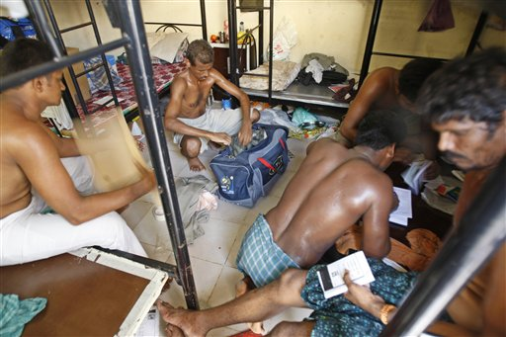
Notes:
-The workers have an average income of 10AED per day, they pay up to 0.99 AED/min to call home, making it impossible to connect with their families regularly
-Thousand of South Asian workers arrive to Dubai to work for better future.
-Cocke creates a phone booth with the currency of a bottle caps of 500ml bottle that cost 2.5AED for 3 minutes
-Not only a cheaper phone call, but a refreshing drink

Slide 4
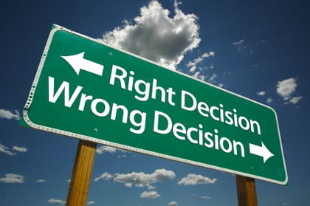
Knowledge vs. right morals
Coke has the knowledge, yet is exploiting the workers due to their naiveness.

Slide 5
Extracting morally significant aspects using reason from the perception of the current situation

Slide 6
To what extent might possession of knowledge carry with it moral obligations?

Slide 7
NONE its all about the business
Notes:
-Playing on the side of devil’s advocate and argue that the workers will need to pay for the coke, it still works cheaper for them.
-Coke creates a phone book with the currency of bottle caps of 500ml bottle with cost around 2.5aed for 3min compared to $0.91/min
-They also get to have a refreshing drink

Slide 8
Notes:
-Knowledge comes with many moral obligations due to the fact the Coke company knows all the bad side affects of drinking too much coke.
-Because of the low salary workers buy cheap sugary foods to increase their energy levels though they increase their chances of diabetes, or worsen them.

Slide 9
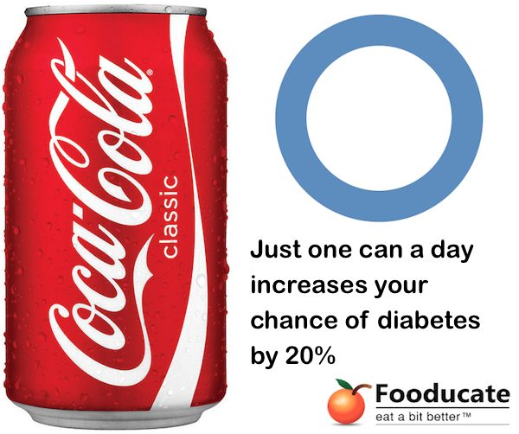
355ml ->

Slide 10
Cheaper Phone call
Boost of energy

Slide 11
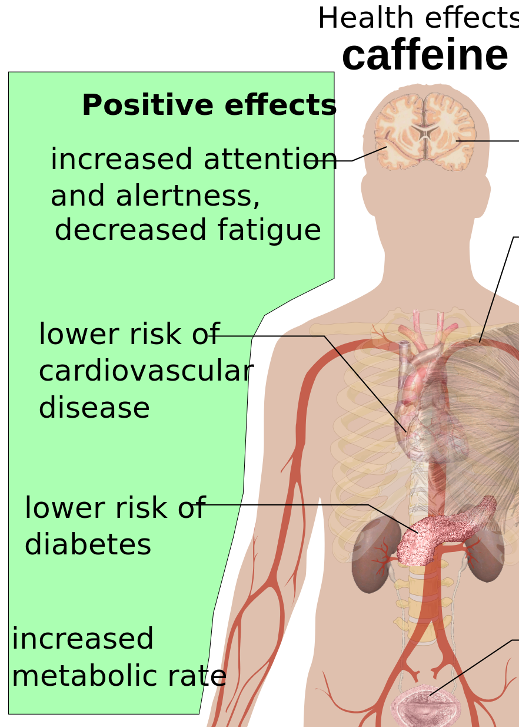
Positive affects
Contains:
-Caffeine for energy: makes a person more alert and increase performance on certain tasks

Slide 12
Do moral truths exist?

Slide 13
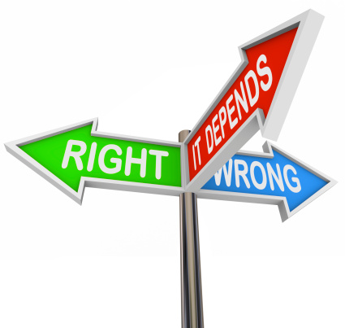
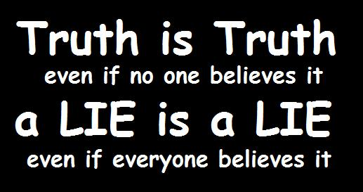
Notes:
-Moral truth refers to the event that are seen to be morally upright.
-They are also principles and values that are accepted in the community by people and they are regarded as good decent.

Slide 14
To what extent is it right for coke to take advantage of their uneducated customers through their new machine?

Slide 15
Notes:
From saying that there are many principles and values that are accepted in the community by people regarding things being good and decent, the community of people now have to think what is morally good about this machine and what is not.
1)It is morally good because the workers get to call their families more often and they get to have a nice cool refreshing drink
2)Through it is not morally ok because workers will want to speak to their families more often and they will buy coke more often which increases the profit of coke and also increase health risks in the workers.

Slide 16
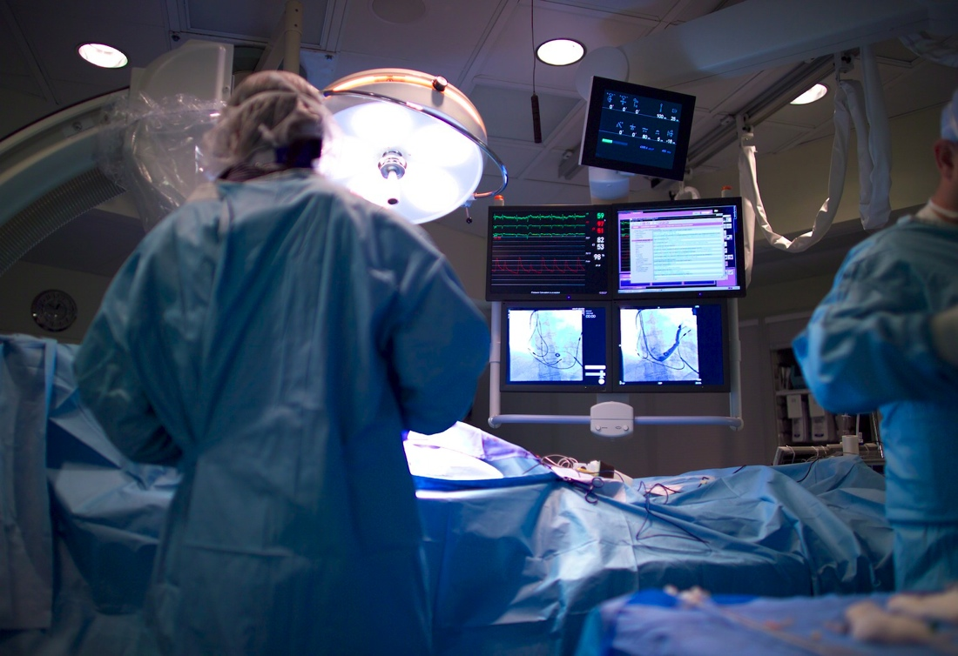
Notes:
-Around 75% of the migrant workers in Dubai do not have health insurance and any health problems that occurs for them cannot be resolved easily.
-From medical bills workers may not be able to send enough money back home.

Slide 17
Hope

Slide 18
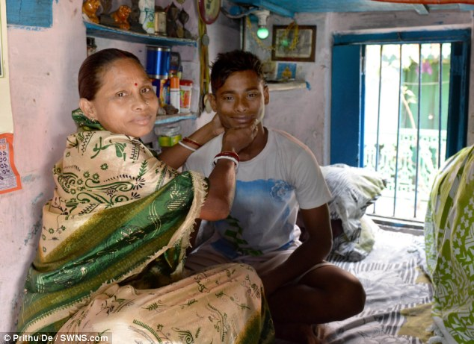

Slide 19
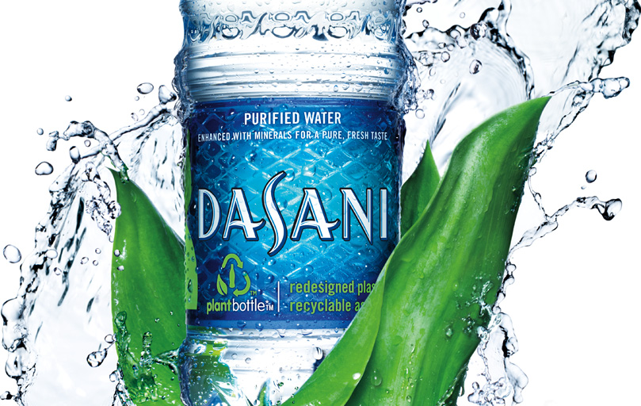
Return to Real Life Situation -Conclusion
Notes:
Instead of coke advertising a fizzy drink they should advertise water. They could be be selling the product for the same amount of money but with a better moral value.
1)Workers will be hydrated more often
2)Coke will be getting the profit that it wants
3)Both sides will be getting positive impact towards them.

Slide 20
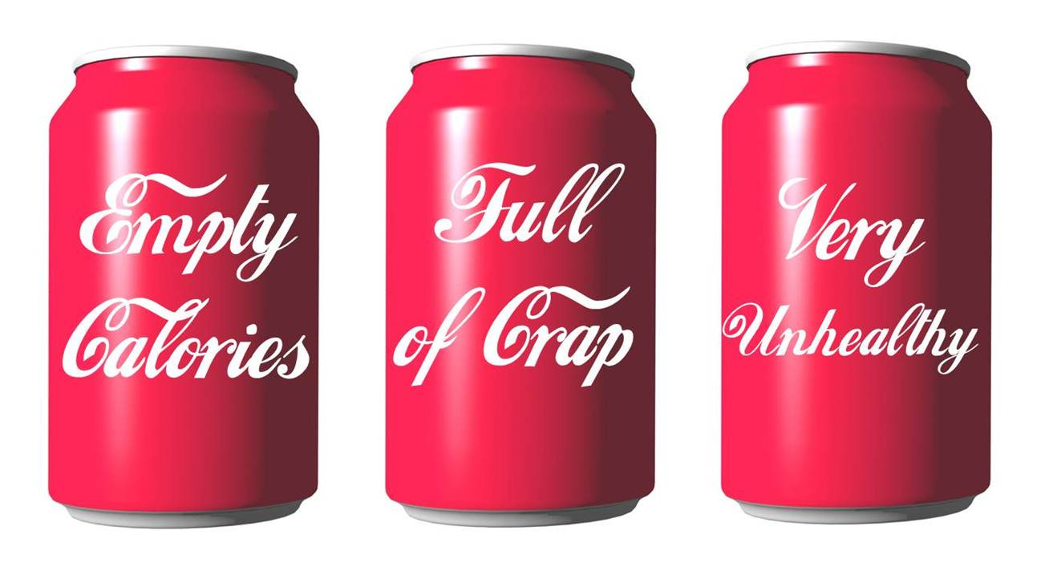
Notes:
Coke is doing a good thing by trying to connect migrant workers to their families. Though the company should try to think more about about the downside of the happiness machine and give the workers a healthier decision than coke.

